Slide 1
Compassion Here and Now
Exploring a Process Buddhism

Slide 2
What is Process Buddhism?
Process Thought is a philosophical tradition with followers worldwide, influenced by the organic philosophy of Alfred North Whitehead, a late philosopher and mathematician. The idea of "process" has become not only a philosophy or worldview but also a way of life, referred to as the global process movement. While Buddhism is a rich and diverse tradition with followers worldwide, it is often categorized into three groups: Mahayana, Theravada, and Vajrayana. It includes both theistic and non-theistic traditions, with Zen Buddhism being non-theistic and Pure Land Buddhism being theistic as it appeals to cosmic Bodhisattvas. ​ There are notable areas of overlap between various forms of Buddhism and Process thinking, suggesting the potential for a Process Buddhism that combines elements from both traditions. This new approach would not be strictly Buddhist or Process but rather a third way that could be embraced by individuals of different paths. Here are twenty concepts to explore in the development of a Process Buddhism.

Slide 3
The Influence of Zen and Pure Land
Many of the ideas on the following slides reflect the influence of Zen (Chan) and Pure Land Buddhism as found in Chinese, Japanese, and Korean traditions.
They are not as indebted to Theravada and Vajrayana ways of thinking, although they carry their influence.
Our thinking about Emptiness reflects the influence of the Kyoto School of Japanese Buddhist philosophy.
Our hope is that many forms of Process Buddhism will be developed, some of which may be more Vajrayana and Theravada in flavor.

Slide 4
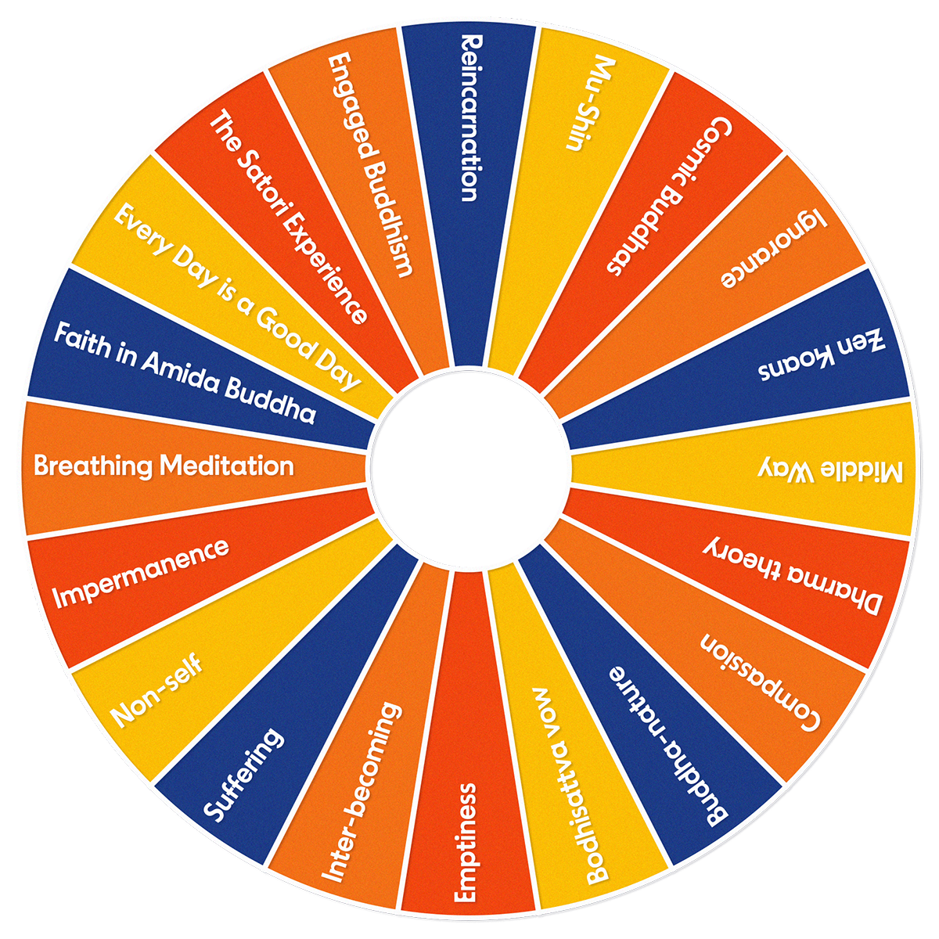
Process Buddhist
Concepts

Slide 5
Mutual Becoming Here-and-Now
The practice of breathing meditation and focusing on physical sensations, connecting with the present moment through the body's awareness.
The concept of mu-shin (no-mind) as the practice of living attentively, spontaneously, and in the present moment, without self-conscious ego. Mu-shin is always here and now. It can include thinking, remembering, and anticipating. Always it is present to what is happening.
The principle of inter-becoming (pratitya-samutpada) and Whitehead's idea of relativity, every actuality is “present in” every other actuality.
Compassion as the ability to feel the feelings of others, taking their perspective, recognizing that the world is my body and that "my self is my neighbor."
The Bodhisattva vow and the inwardly felt calling (lure) to wisdom and compassion, to "return" again and again to this world until all living beings are saved.
Reincarnation and a recognition of a continuing journey after death.

Slide 6
Cosmology and the Buddha-Nature
Dharma theory and the concept of a universe made up of individual moments (actual occasions).
Buddha-nature (tathagata-garbha) and the inherent spontaneity and aliveness of all things in the universe. It is not that things "have" the Buddha-nature; they are the Buddha-nature. (Dogen)
Impermanence (anitya) and the constant fading of our subjective experiences, the perpetual perishing of all subjective immediacy.
Suffering (dukkha) as a result of the fleeting nature of satisfaction and the realization that the satisfied self is never truly stable. Don't hold on.
The Middle Way (Madhyamika) and the practice of non-attachment to ideologies and abstractions, avoiding the fallacy of misplaced concreteness.
Non-self (anatman) and Whitehead's idea that the self is a series of experiences with no distinct, separate entity called “the self.”

Slide 7
Emptiness and Amida (God)
Emptiness (sunyata) as ultimate reality. All things are empty of substance and full of interbecoming: spontaneous, relational moments in a non-substantial field of potentiality.
Emptiness as existential self-emptying (mu-shin), kenosis, requires Great Doubt and Great Death.
Amida Buddha as the primordial expression of Emptiness. Infinite Wisdom and Compassion. Pure Land Buddhism.
Emptiness as the ultimate reality and God (Amida) is the ultimate actuality. John Cobb.
Cosmic Buddhas (Adi-Buddha/Amida Buddha/Vajradhara/Samantabadhra, etc.) as embodiments of the energy and archetypes within the collective unconscious and/or as incarnations of the consequent nature of God.

Slide 8
Spirituality and Social Transformation
Ignorance (avidya) and awakening (vidya) as the process of moving away from substance thinking and towards a sense of the mutual becoming (pratitya-samutpada).
Koans (e.g. the mu koan) as a means of awakening to the intuitive side of life, entering into the great death of self-conscious ego and knowable self.
The satori experience as a sudden awakening to a new level of spiritual understanding, awareness of interconnectedness, always expanding.
"Every Day is a Good Day" as a reminder to incorporate spirituality into daily life and the recognition of the power of attitude.
Socially engaged Buddhism and the recognition of the importance of ecological civilization and creative localization.

Slide 9
Process Buddhism as Eco-Buddhism
Humanity is at a crossroads. We can learn to live in harmony with one another and the more-than-human world or we can perish, bringing along many other forms of life with us: global climate change, the threat of nuclear war, economic inequities, hyper nationalism, political authoritarianism.
Process thinkers speak of the world’s best hope as Ecological Civilizations: societies in which people live with respect and care for one another and the larger web of life, in communities that are compassionate and just.
Process Buddhism can play a role. It will not do so as a separate tradition. It will do so as its ideas are incorporated into the lives of self-identified Buddhists, Christians, Jews, Muslims, and spiritual independents – each in their own way. Double religious belonging, spiritual hybridity.
The key is to practice on a daily basis; get involved in service to community; and work with others to help heal a broken world, thus extending the Bodhisattva spirit, however named and understood. Compassion here and now.

