Slide 1
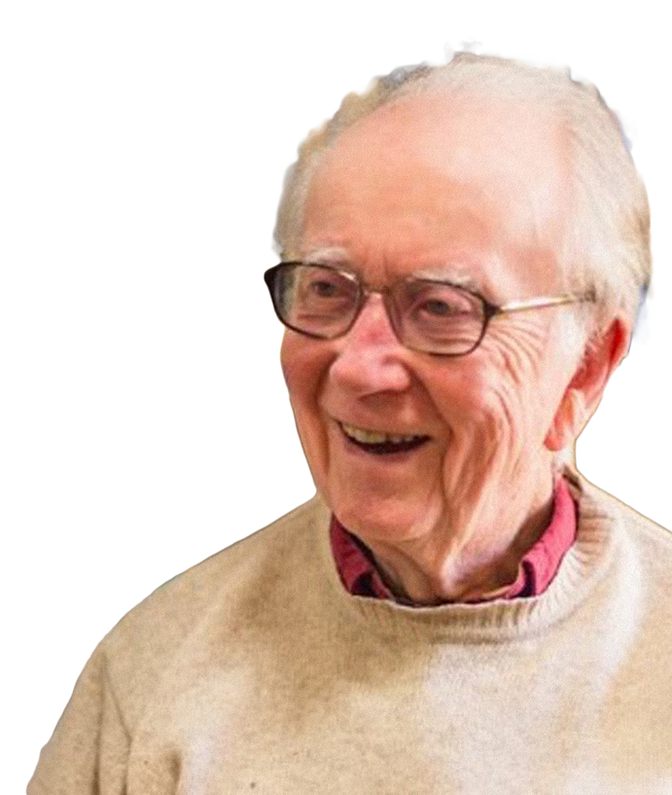
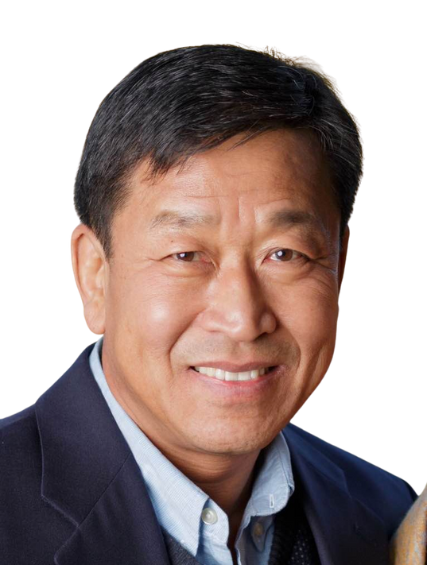
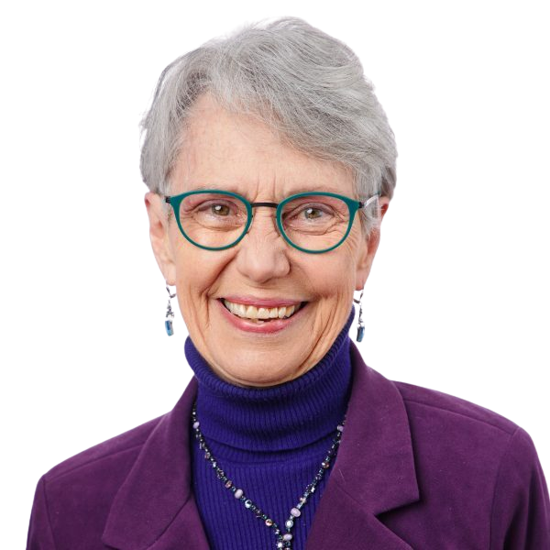
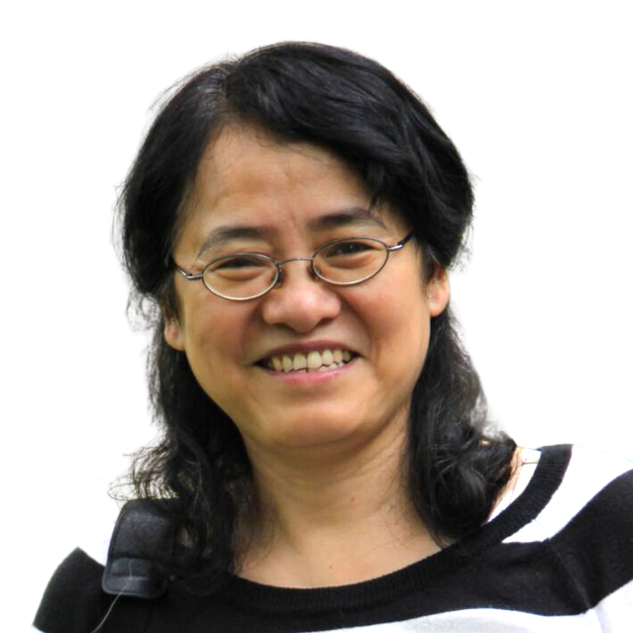
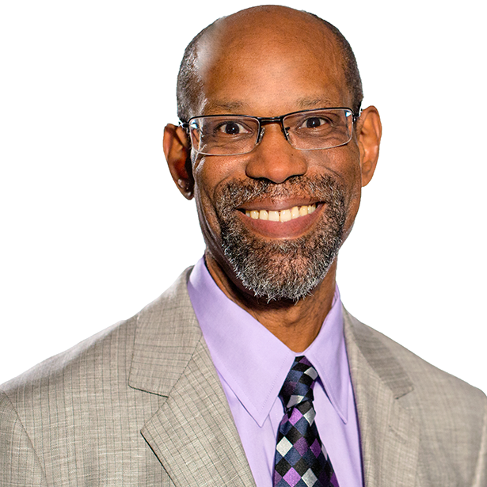
Cobb Institute
Mission & Vision

Slide 2
Our Mission
The Cobb Institute promotes process and relational ways of understanding and living in the world, seeking to cultivate ecological civilizations through just and compassionate communities.

Slide 3
Our Vision
Our vision is to advance wisdom, harmony, and
the common good
through holistic education, community building, and spiritual exploration.

Slide 4
We Work Toward Transformations...

Slide 5
From a world of static objects to
a process of dynamic becoming

Slide 6
From a fragmented world to a relational world

Slide 7
From a human-centered world to an eco-centered world

Slide 8
From isolated communities to communities of communities

Slide 9
From oppressive social orders to a world of justice

Slide 10
From mutual defensiveness to mutual support

Slide 11
From the goal of wealth to the goal of happiness and wellbeing

Slide 12
From isolated individuals to persons-in-community

Slide 13
From knowledge as mere data to knowledge as wisdom nourished by multiple ways of knowing

Slide 14
From the primacy of analysis to the primacy of creative synthesis

Slide 15
From attachment to dogmatic ideologies to openness to evidence

Slide 16
From life-denying spiritualities to life-affirming spiritualities

Slide 17
From nature as mechanistic to nature as alive

Slide 18
From coercive power to the power of love

Slide 19
cobb.institute

