Slide 1
Process & Interfaith
14 points
for reflection

Slide 2
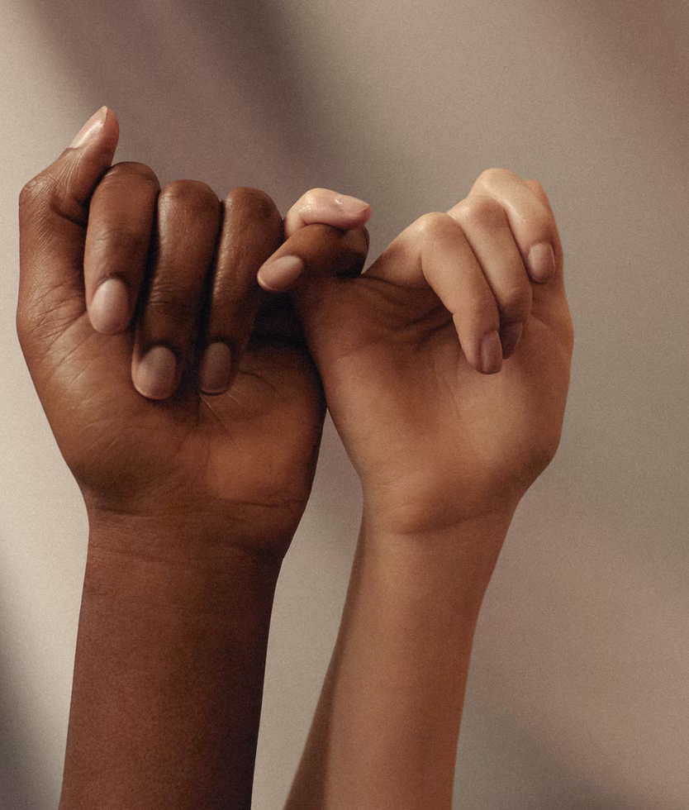
Differences make the whole richer
As people from different traditions enter into dialogue and cooperative relations, they can and should bring what is most important to them to the table. They don't have to leave their roots behind. Differences make the whole richer.

Slide 3
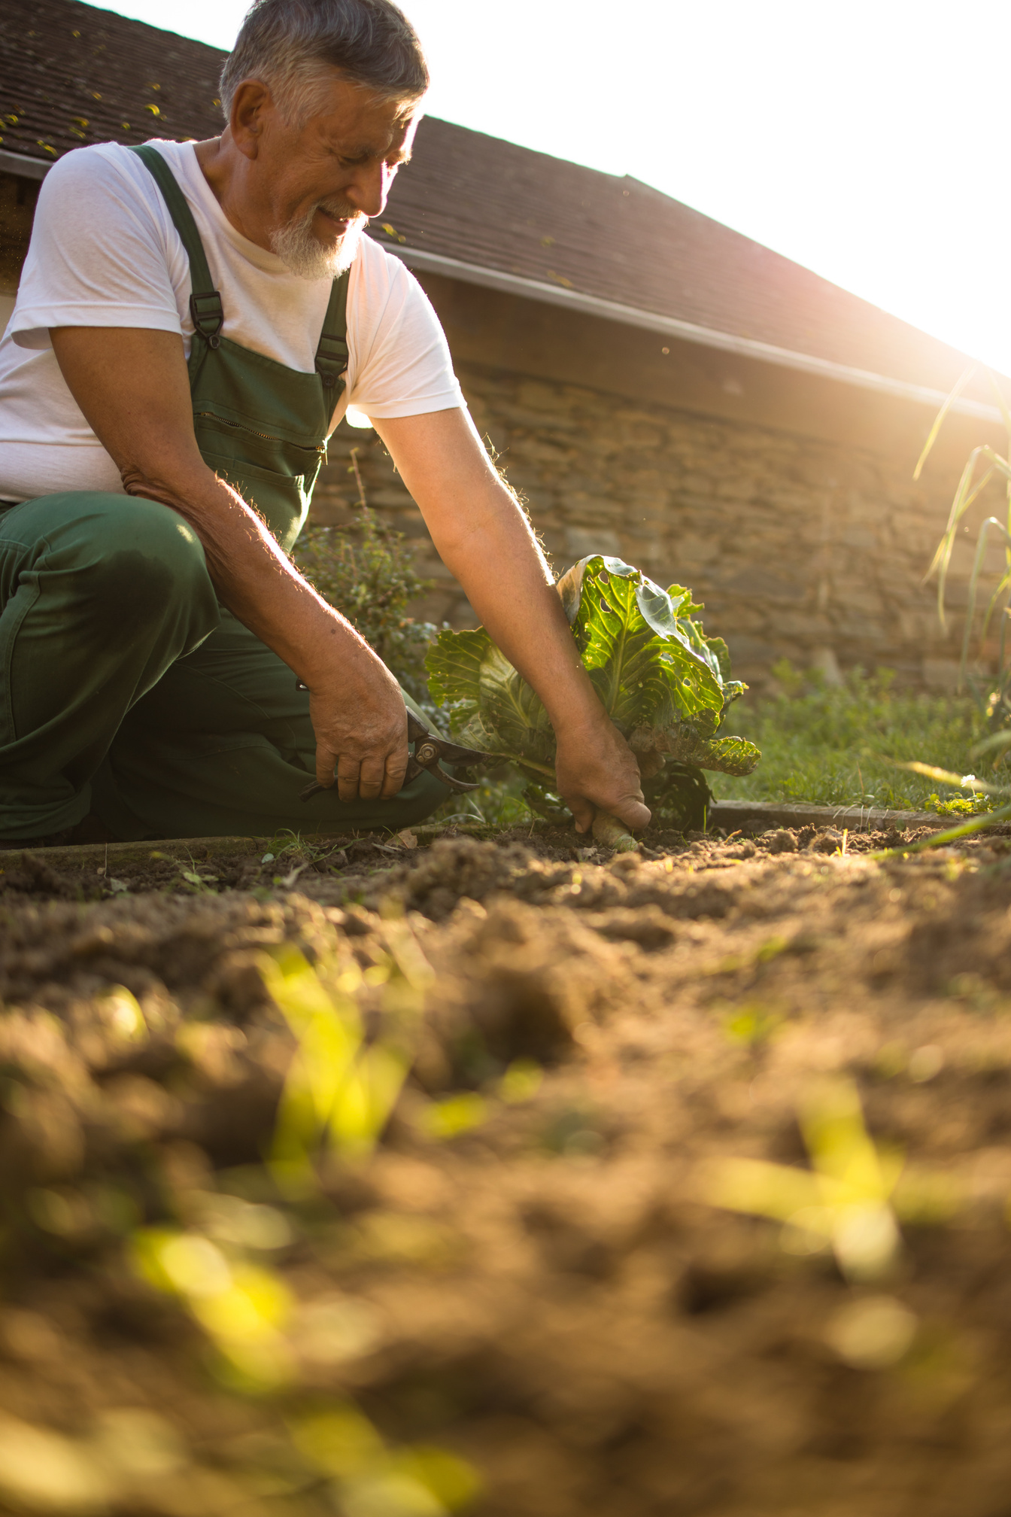
We are part of the Earth
Interfaith dialogue can include a dialogue with the earth, because human life is nested within, not apart from the wider web of life. Environmental education and inter-faith dialogue can go hand in hand. All creatures have their own kind of spirituality. Subjectivity goes all the way down.

Slide 4
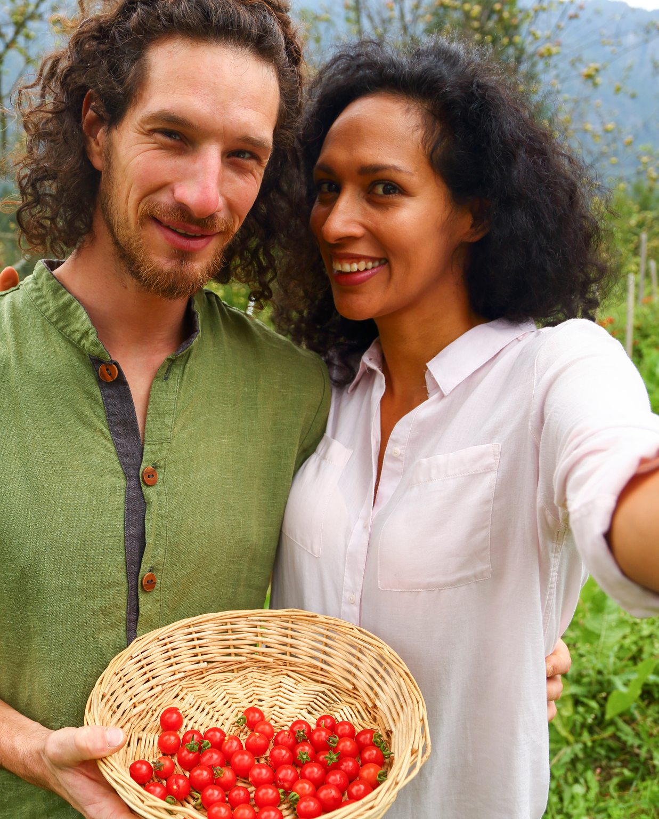
The need to build transition communities
In an age of global climate change, one aim of interfaith dialogue and cooperation is to help build post-petroleum communities that are creative, compassionate, participatory, multi-religious and ecologically wise, with no one left behind. The common good of the world is not simply community, it is eco-community.

Slide 5
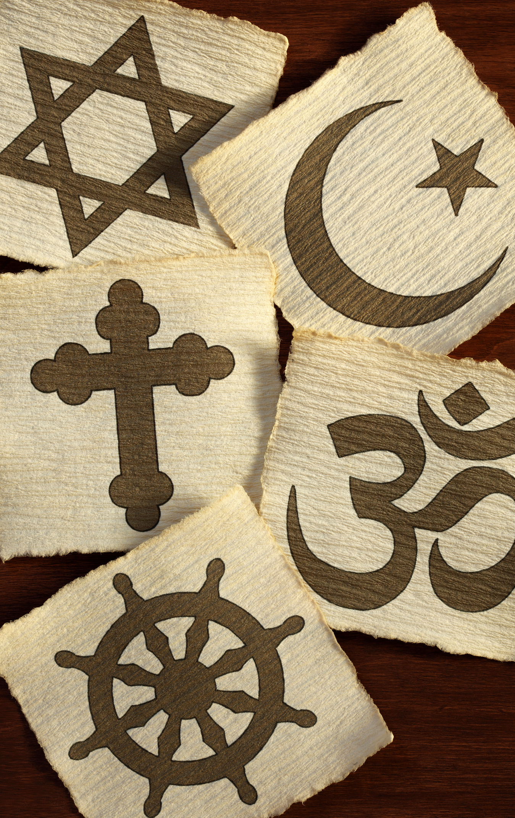
There may be many forms of ultimacy
Different religions may highlight different features of reality as ultimately real (interconnectedness, the primacy of the present moment, the value of community, the reality of spirit worlds, the love of God). For one religion to be right, the others do not need to be wrong. They can be right about different things. The truths are many.

Slide 6
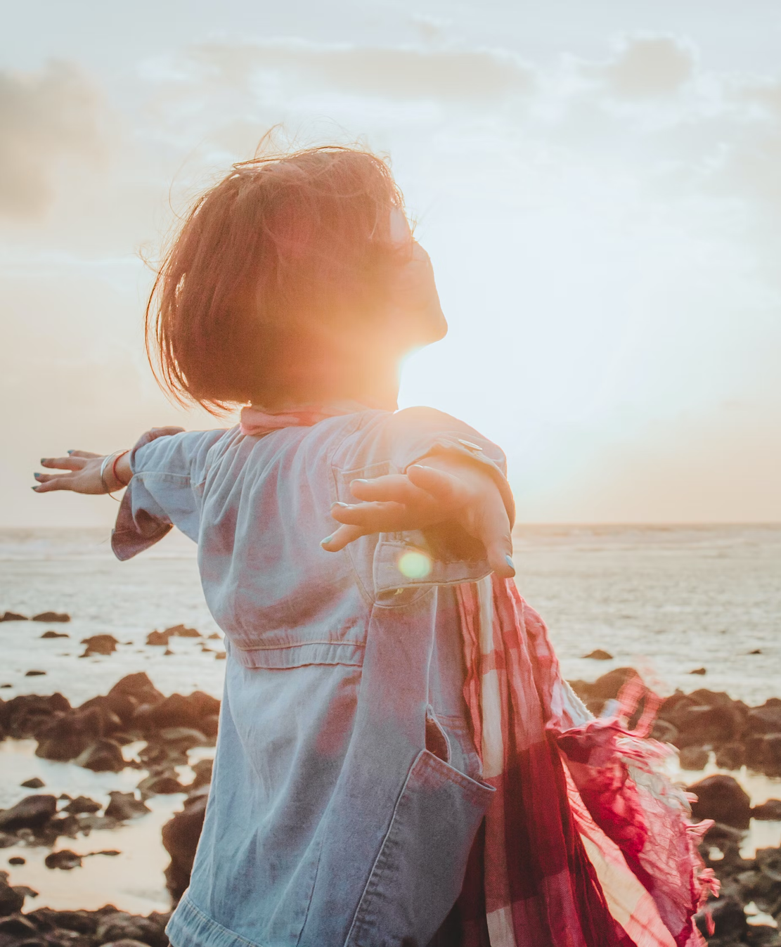
There may be many forms of salvation
There may be different forms of salvation, corresponding to the diverse ultimates. One religion may highlight a form of well-being that emerges through an awakening to interconnectedness, another may highlight a form of well-being that emerges by accepting God's forgiving love, and still another may highlight a form of well-being that finds meaning in concourse with the spirits. Different religions do not need to have the same goals.

Slide 7
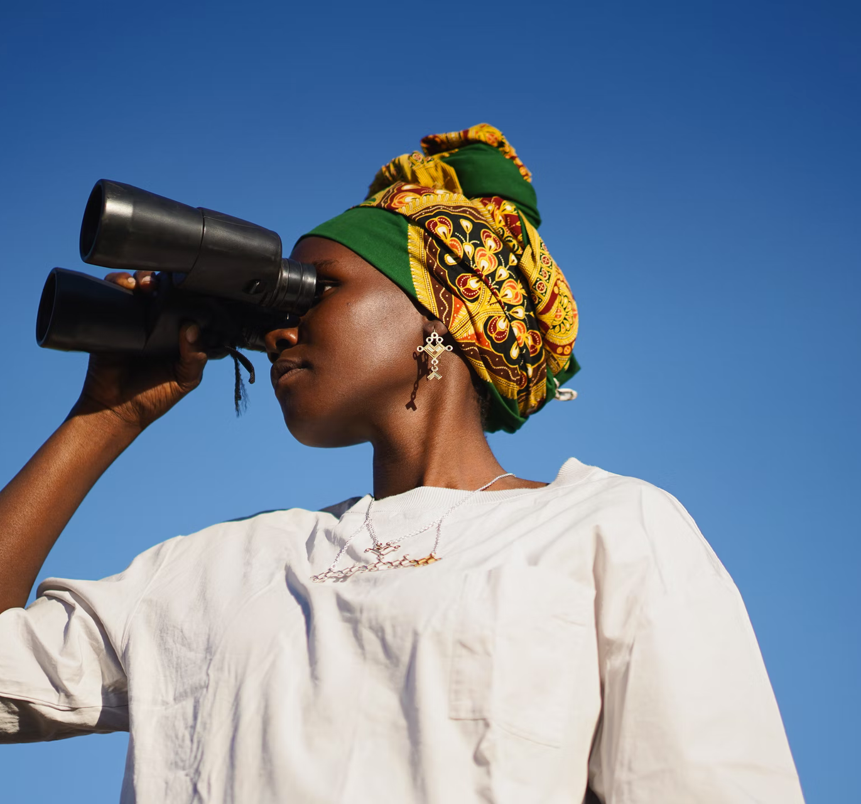
Religions are more than worldviews
There is much more to religion than worldviews and beliefs. Religions include community, rituals, images, sounds, hopes, dreams, and stories. Sometimes it is these things—not the worldviews—that is most important to people.

Slide 8
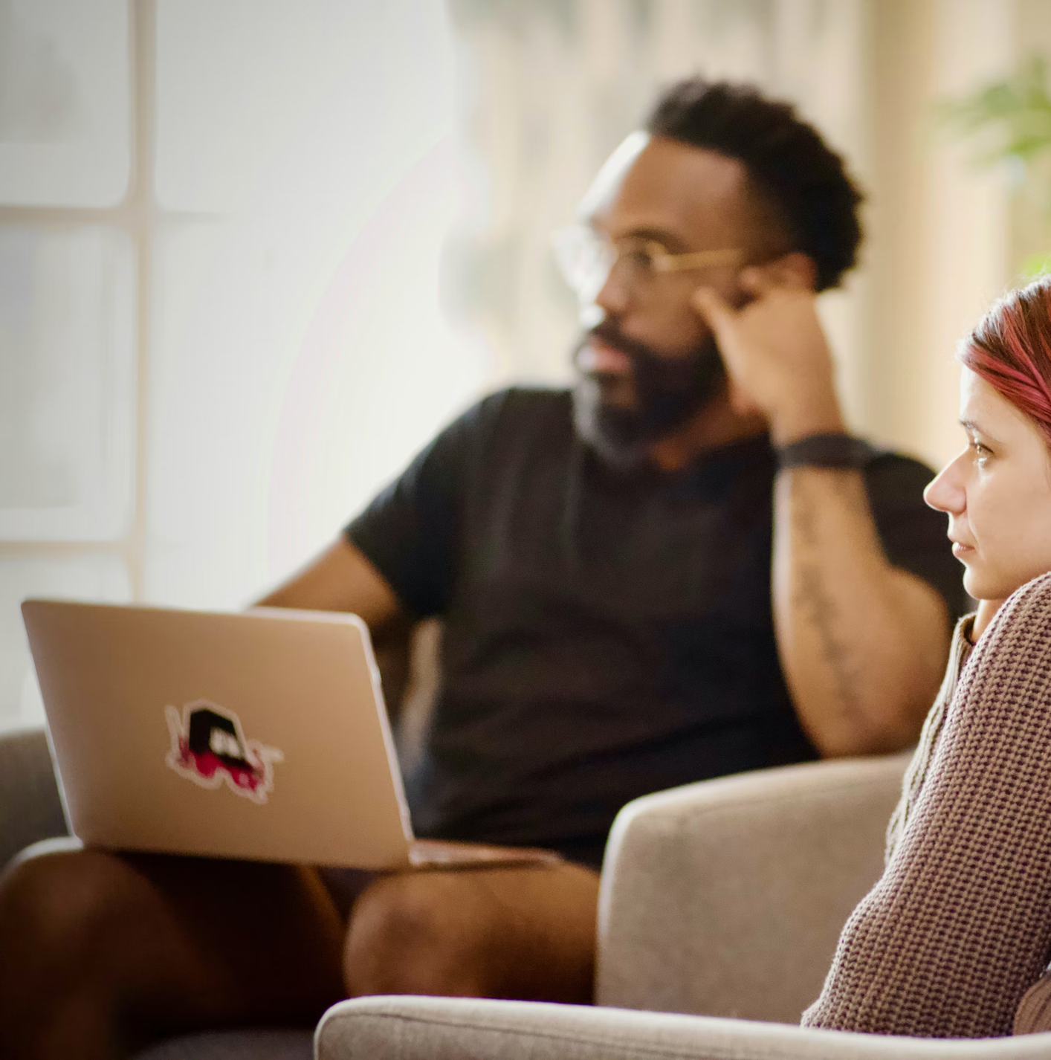
We learn by listening
We can bring to interfaith dialogue an appreciation of the role of the arts and music in dialogue, cognizant that, when it comes to knowing the religious other, there are many ways of knowing, including visual and musical and bodily knowing. Prayer and meditation are forms of knowing, too.

Slide 9
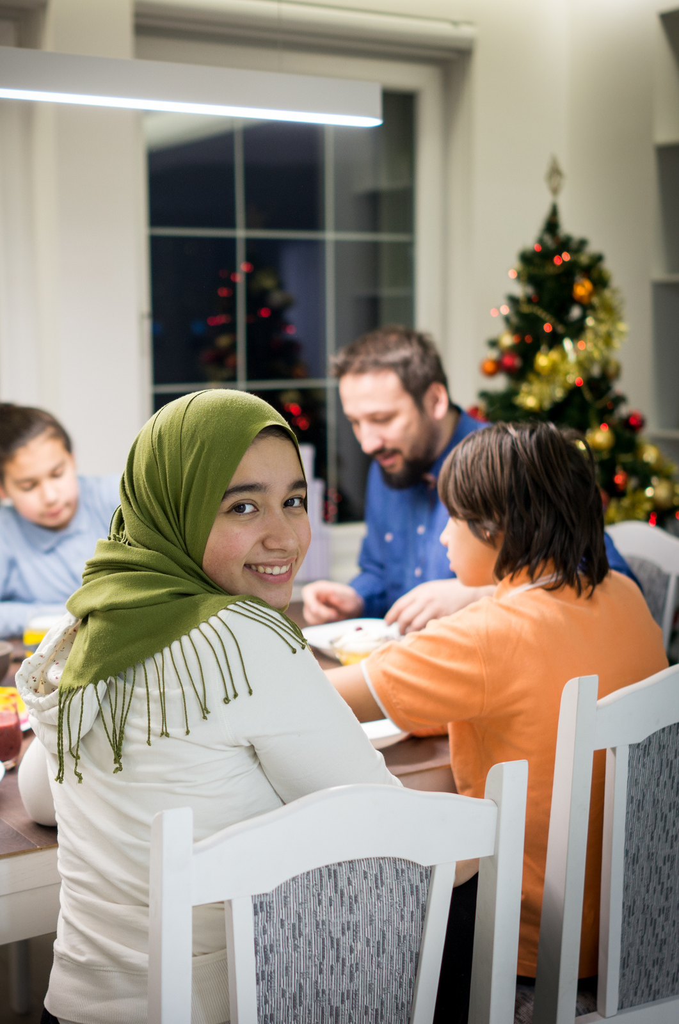
We can be transformed by what we hear
One of the aims of dialogue, once trusted relations emerge, is mutual transformation, by which people internalize insights from the other and are transformed in the process.

Slide 10
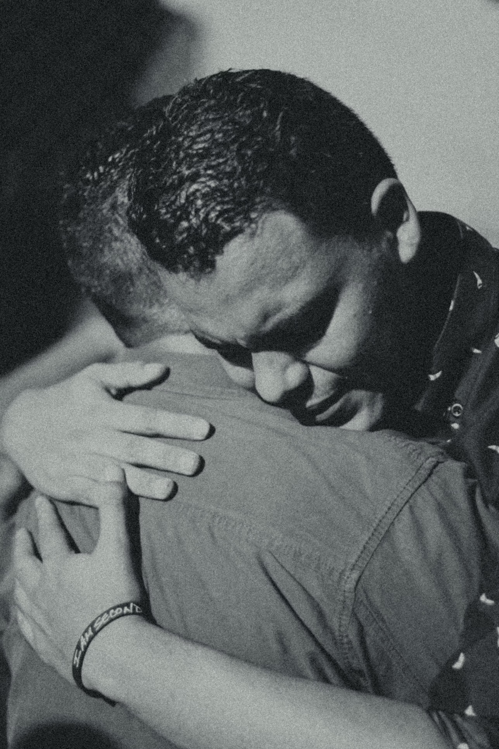
Our capacities for empathy may be more than we know.
Human beings can feel the feelings of other human beings and take on their perspectives, even if they do not have shared histories or common backgrounds.

Slide 11
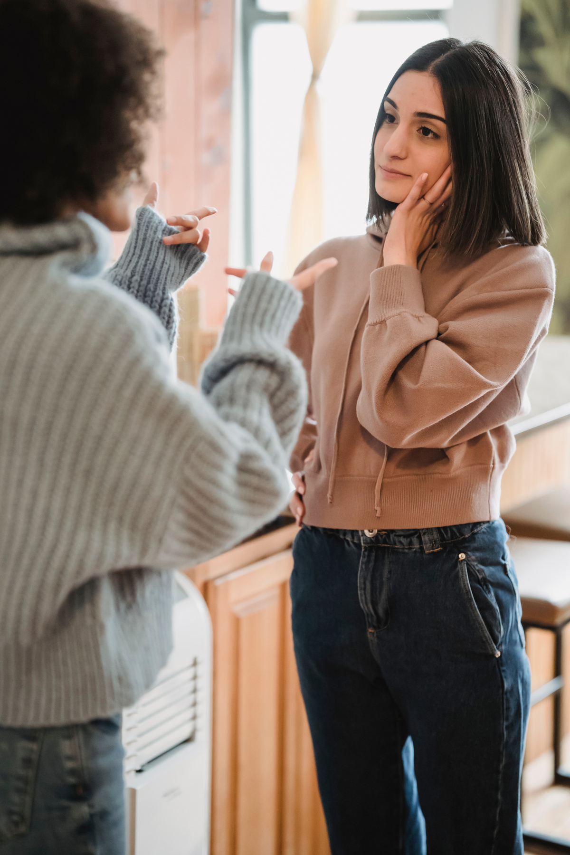
It's alright to critique one another, too.
Once trusted relations emerge, genuine dialogue can include mutual criticism and debate. In genuine dialogue it is alright to say “I disagree.” Often we learn more from disagreements than agreements.

Slide 12
Self-critique is extremely important.
More important than critiquing others is self-critique. If we absolutize our inherited traditions (ritual and intellectual) and make gods of them, we miss the spirit of creative transformation. We have roots without wings.

Slide 13
We may need to reinvent our religions
Religions are evolving through time, and they are never quire reducible to their inherited patterns and worldviews. Interfaith dialogue and cooperation provide opportunities for the creative development of world religions so they grow less violent, less arrogant, and more hospitable to life.

Slide 14
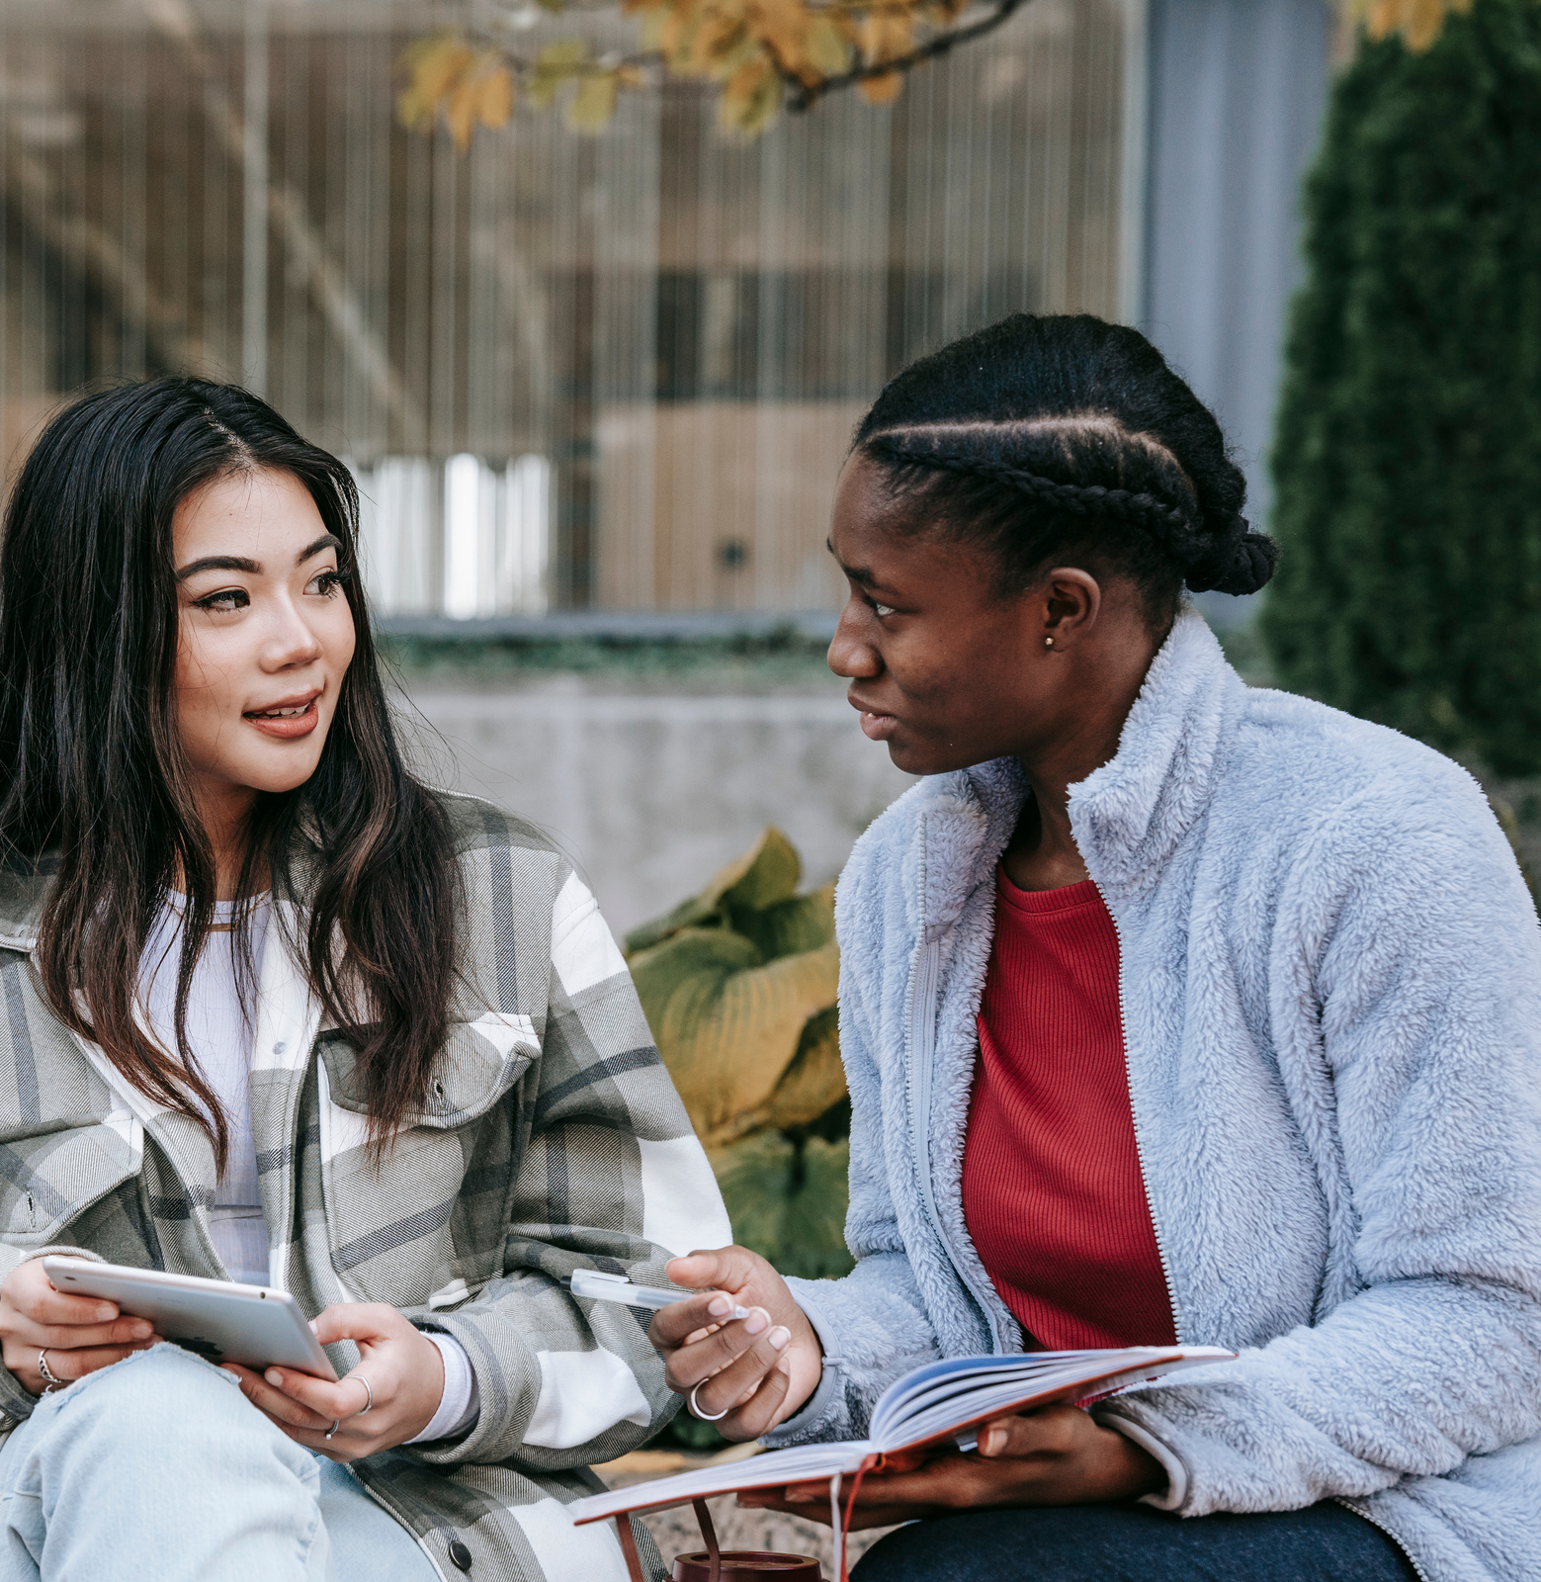
God is a lure toward dialogue and transformation.
The very desire for dialogue and widened horizons comes from a dimension of the universe itself–a divine yearning–that is present throughout the world as a spirit of creative transformation.

Slide 15
Interfaith cooperation
as practicing the presence of God
When we are cooperating with others in respectful ways that help enrich the well-being of life on earth and in local communities, we are practicing the presence of God.

