Slide 1
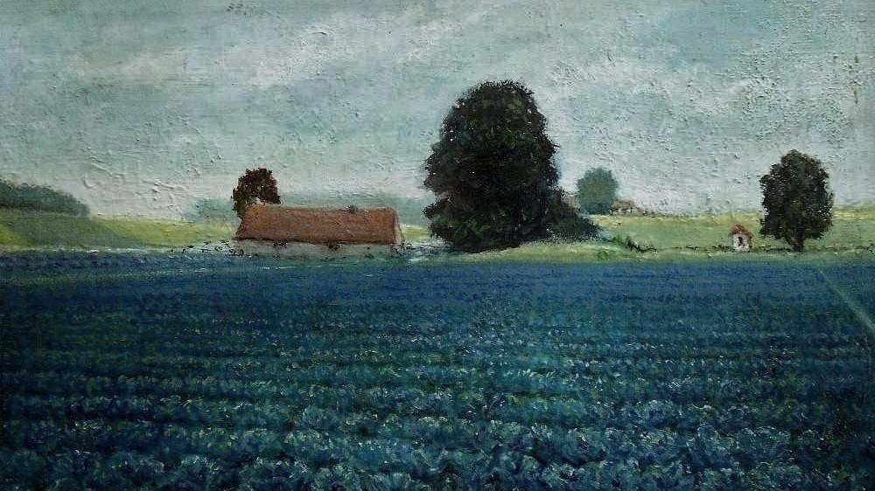
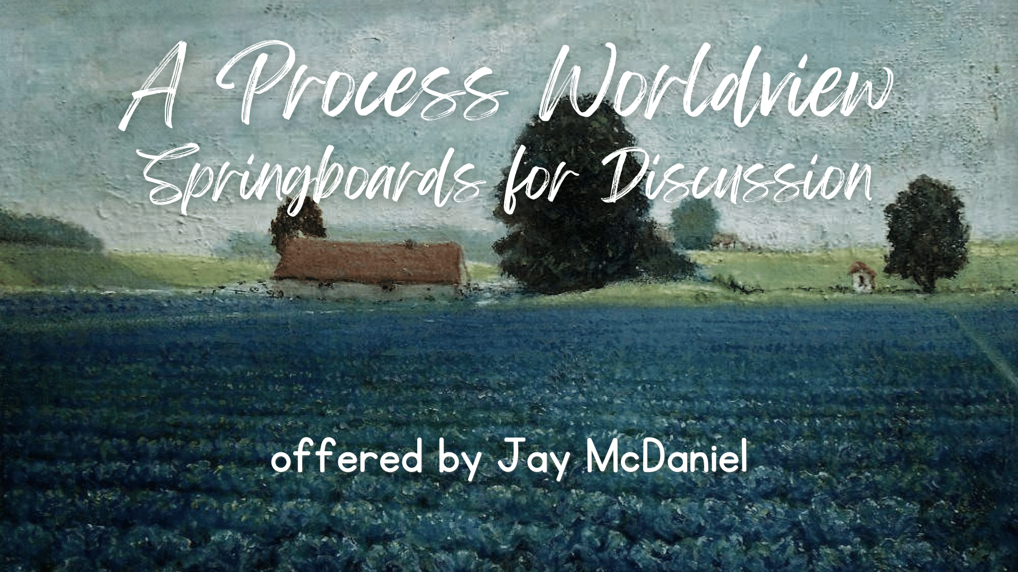
A Process Worldview
Springboards for Discussion
offered by Jay McDaniel

Slide 2
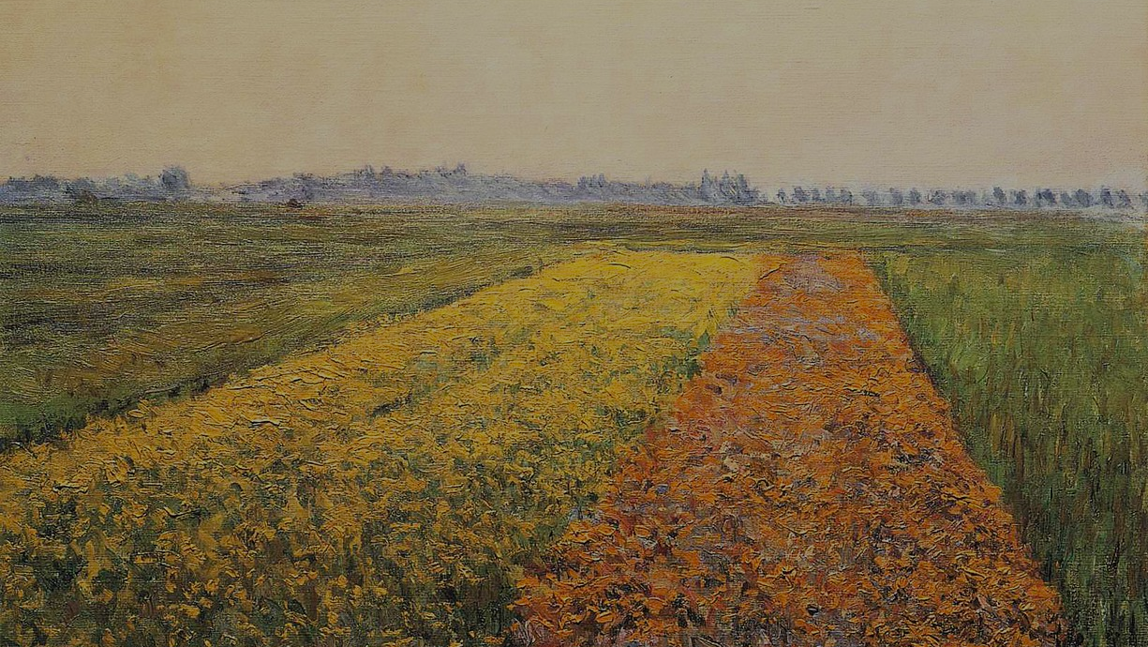
Every moment in a person's life is an act of improvisation: creating something new out of a settled past.
Improvisation goes all the way down into the depths of matter.

Slide 3
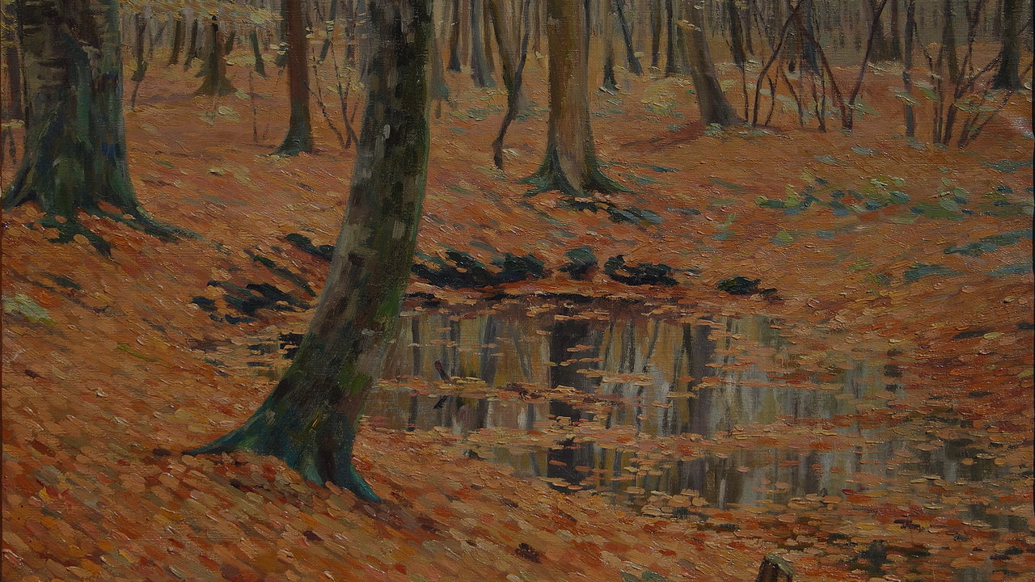
We live in a universe of inter-becoming; each event in the universe carries the influence of, and influences, all others.
The building blocks of the universe are moments and relationships—not 'things.'

Slide 4
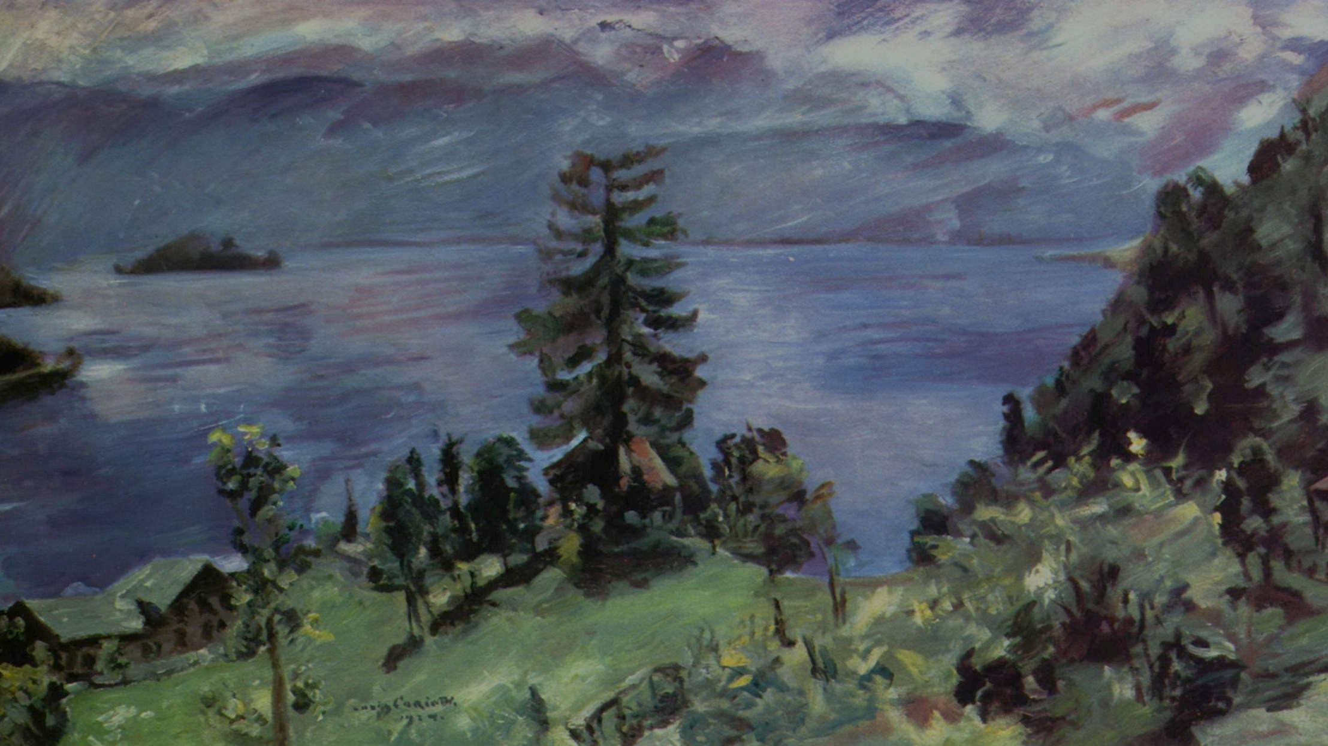
Each and every living being is a subject of its own life with intrinsic value, and not just an object for others.
Injustice lies in denying the value of other lives, other subjects; and it harms all involved.

Slide 5
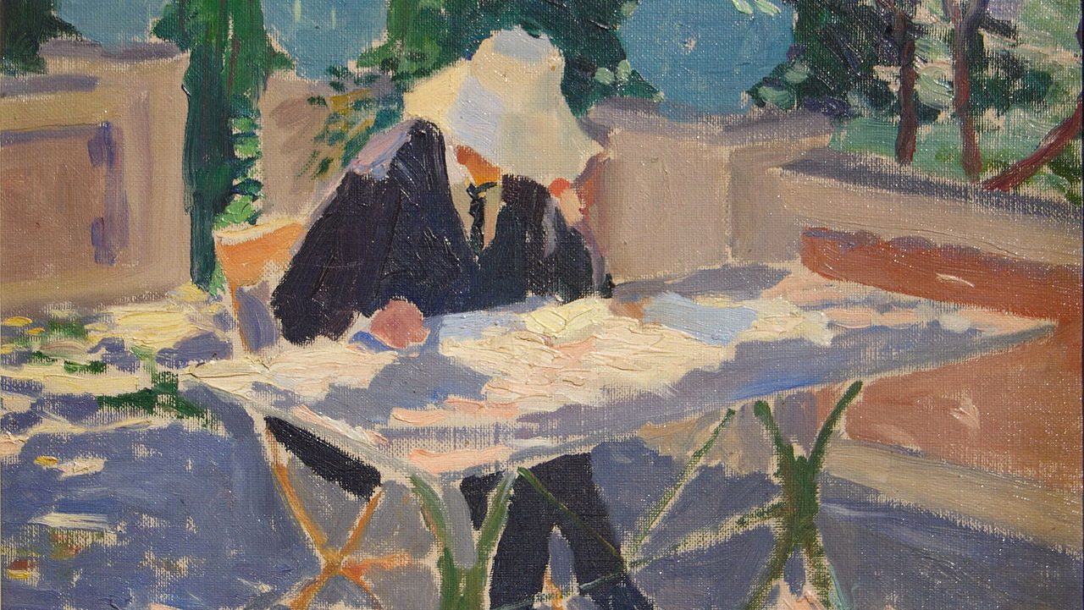
Our human calling is to enjoy life as best we can and to help build communities that are creative, compassionate, participatory, multicultural, humane to animals, and good for the earth, with no one left behind.

Slide 6
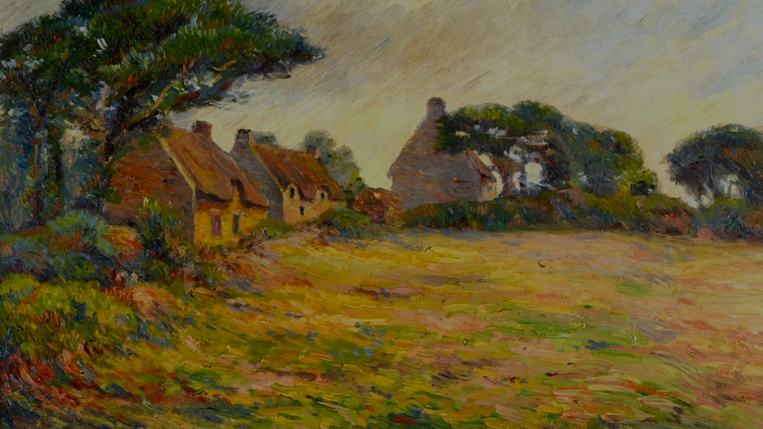
As we seek to fulfill this vocation, we are beckoned by the ideal of Beauty; harmony and intensity of experience. Sensitivity to Beauty includes awe and wonder, zest for life, love, and meaning making.

Slide 7
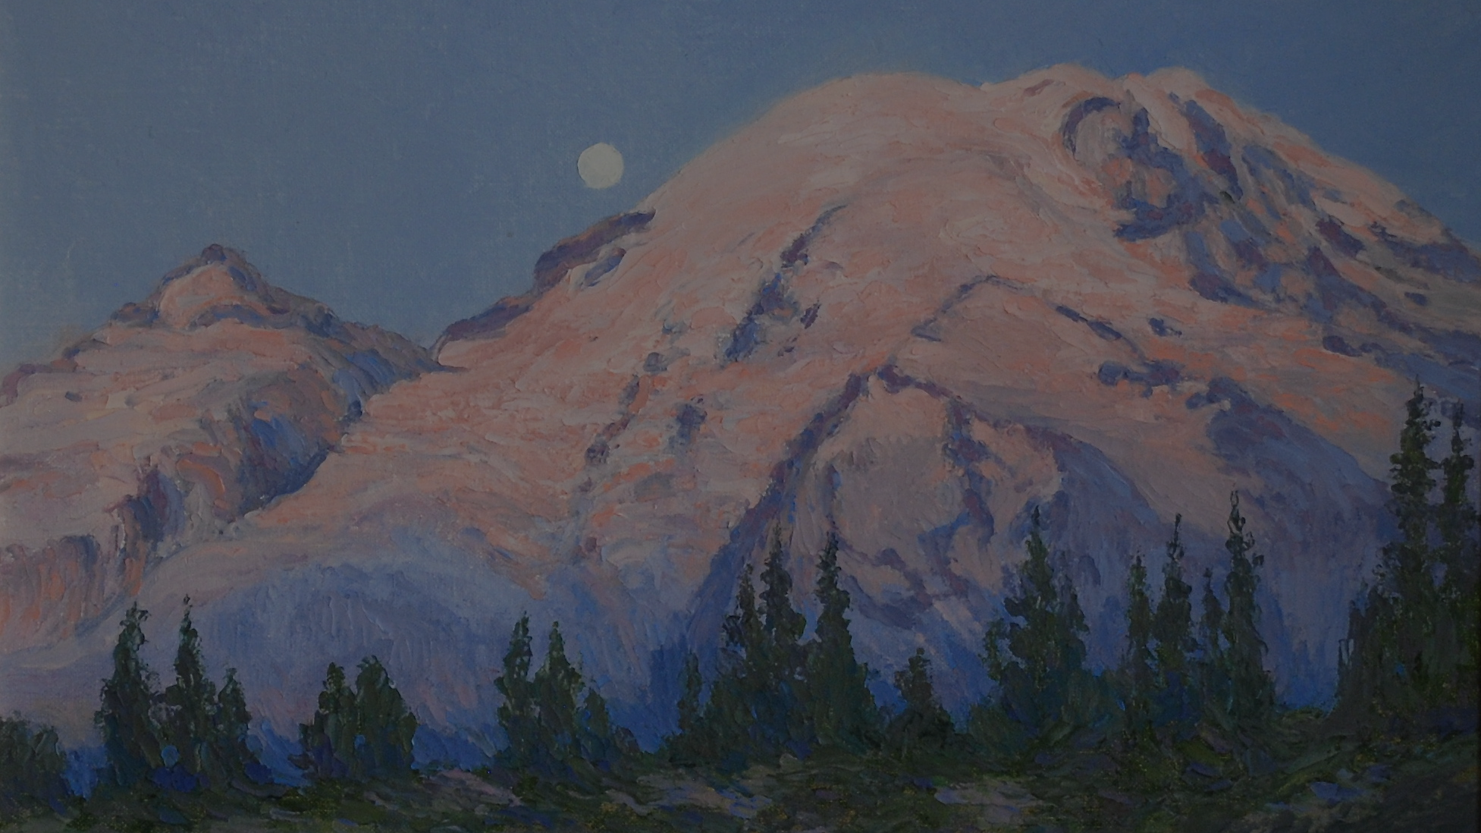
The ideal of Beauty, and its inwardly felt beckoning towards the fullness of life for each and all, is how the Deep Listening of the universe—God—is present continuously in life on earth and the entirety of the cosmos.

Slide 8
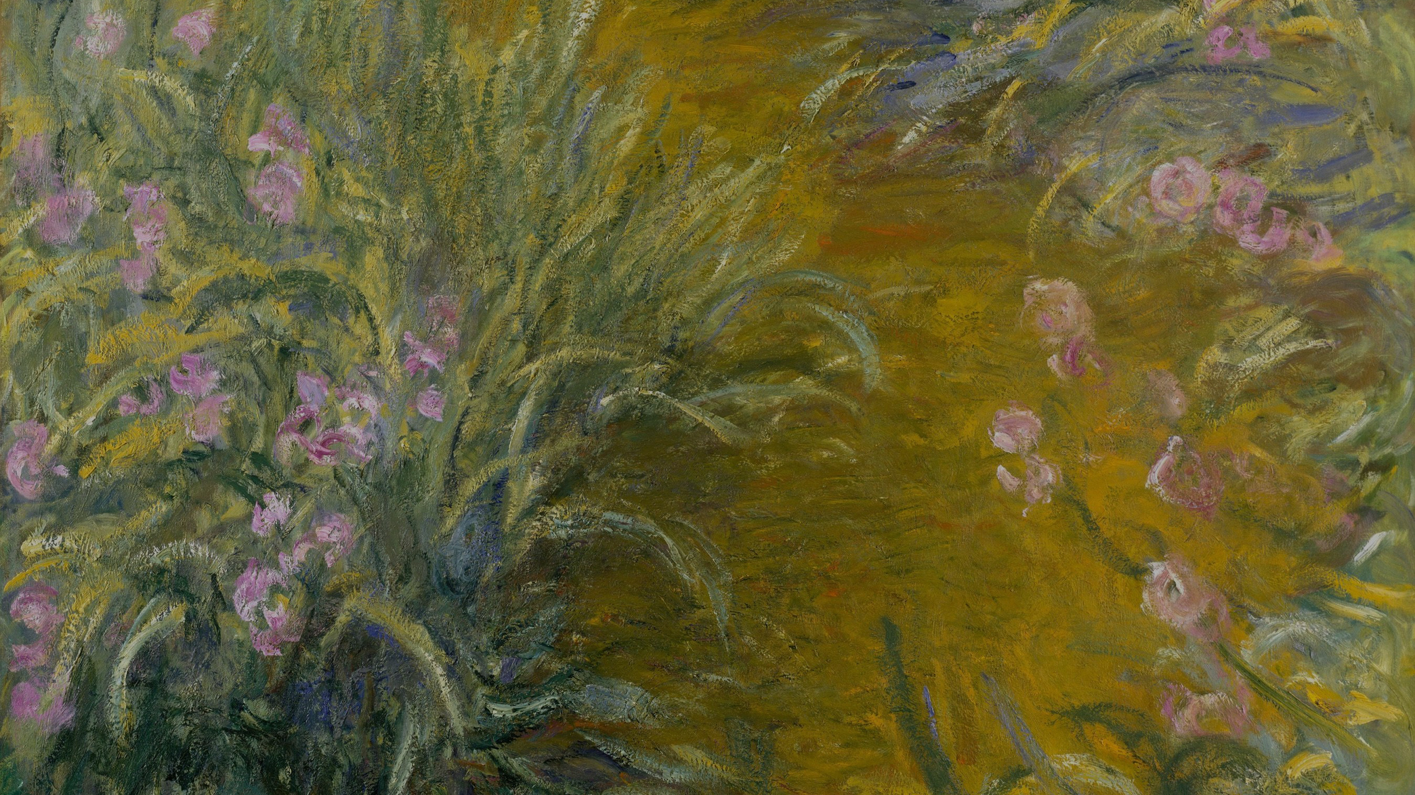
God is present to us as an inwardly felt lure to live with wisdom, compassion, and creativity; and as a companion to the joys and sufferings of all living beings. God acts through persuasion not coercion; the future is open, even for God.

Slide 9
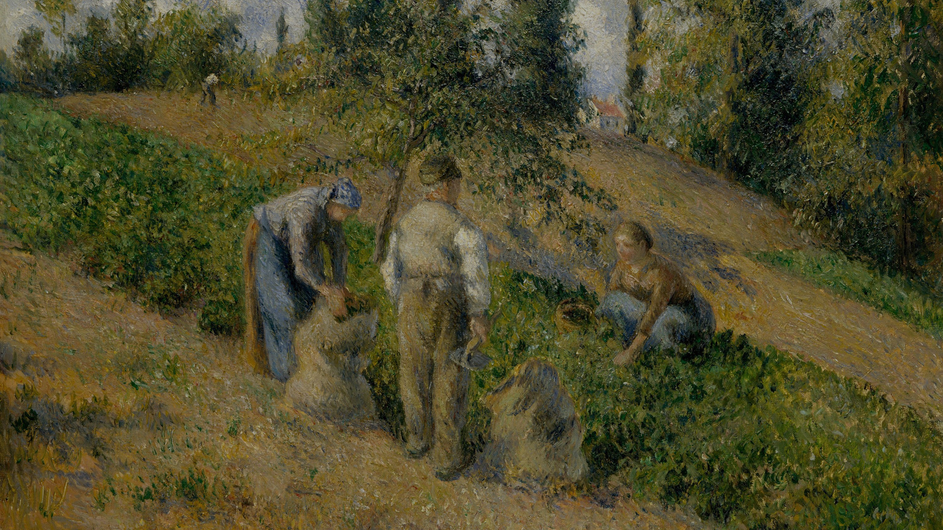
The great work of our time is to help build compassionate communities that are good for people, animals, and the earth-with no one left behind. These communities are the building blocks of an Ecological Civilizations in which people live with respect and care for the community of life.

Slide 10
Each person, each culture, each nation has something to offer an ecological civilization. The goal of such a civilization is not money or power, but rather happiness and the flourishing all life.

Slide 11
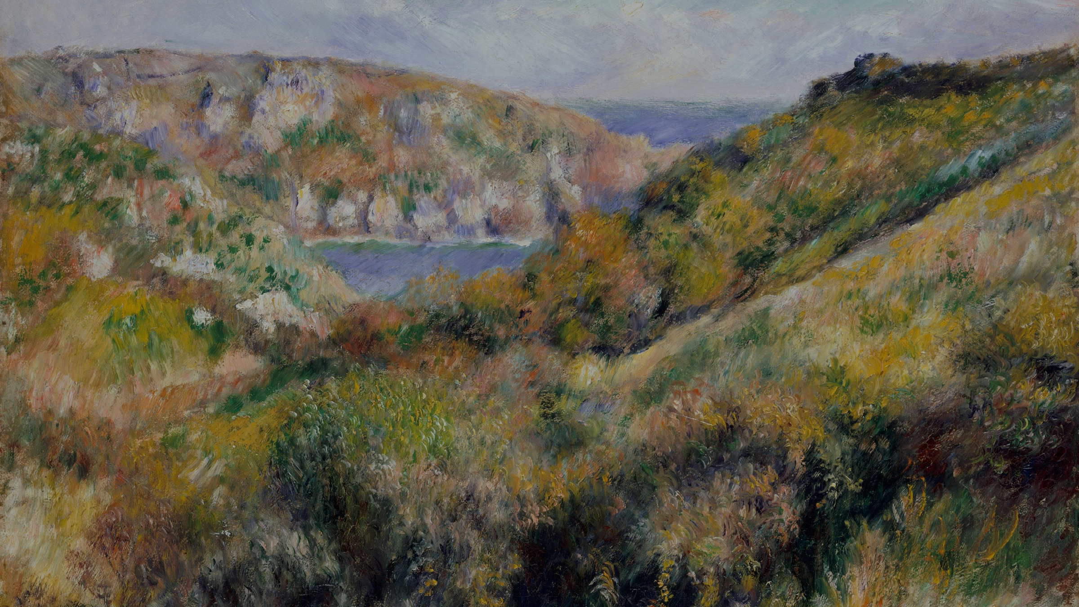
Our planet is an Earth Community or, better, a community of communities of communities. Ecological civilization is the best and only hope for the Earth Community. Time to get started, before it's too late.

Slide 12
cobb.institute

