Slide 1
What is Process Thought?
20 Key Ideas

Slide 2
Process
The universe is an ongoing process of development and change, never quite the same from moment to moment. Every entity in the universe is best understood as a process of becoming that emerges through its interactions with others. The beings of the world are becomings.

Slide 3
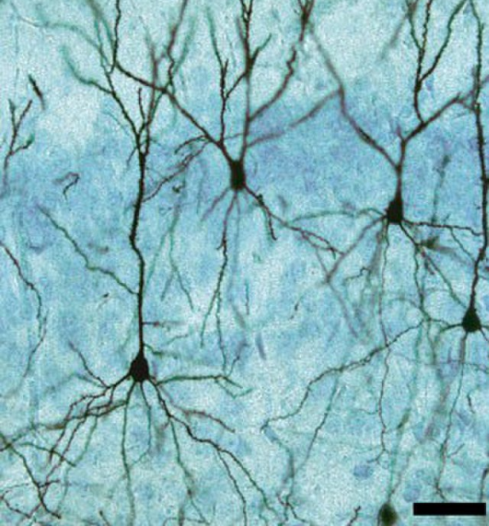
2. Interconnectedness
The universe as a whole is a seamless web of interconnected events, none of which can be completely separated from the others. Everything is connected to everything else and contained in everything else. As Buddhists put it, the universe is a network of inter-being.

Slide 4
3. Continuous Creativity
The universe exhibits a continuous creativity on the basis of which new events come into existence over time which did not exist beforehand. This continuous creativity is the ultimate reality of the universe. Everywhere we look we see it. Even God is an expression of Creativity. Even as God creates, God is also continuously created.

Slide 5
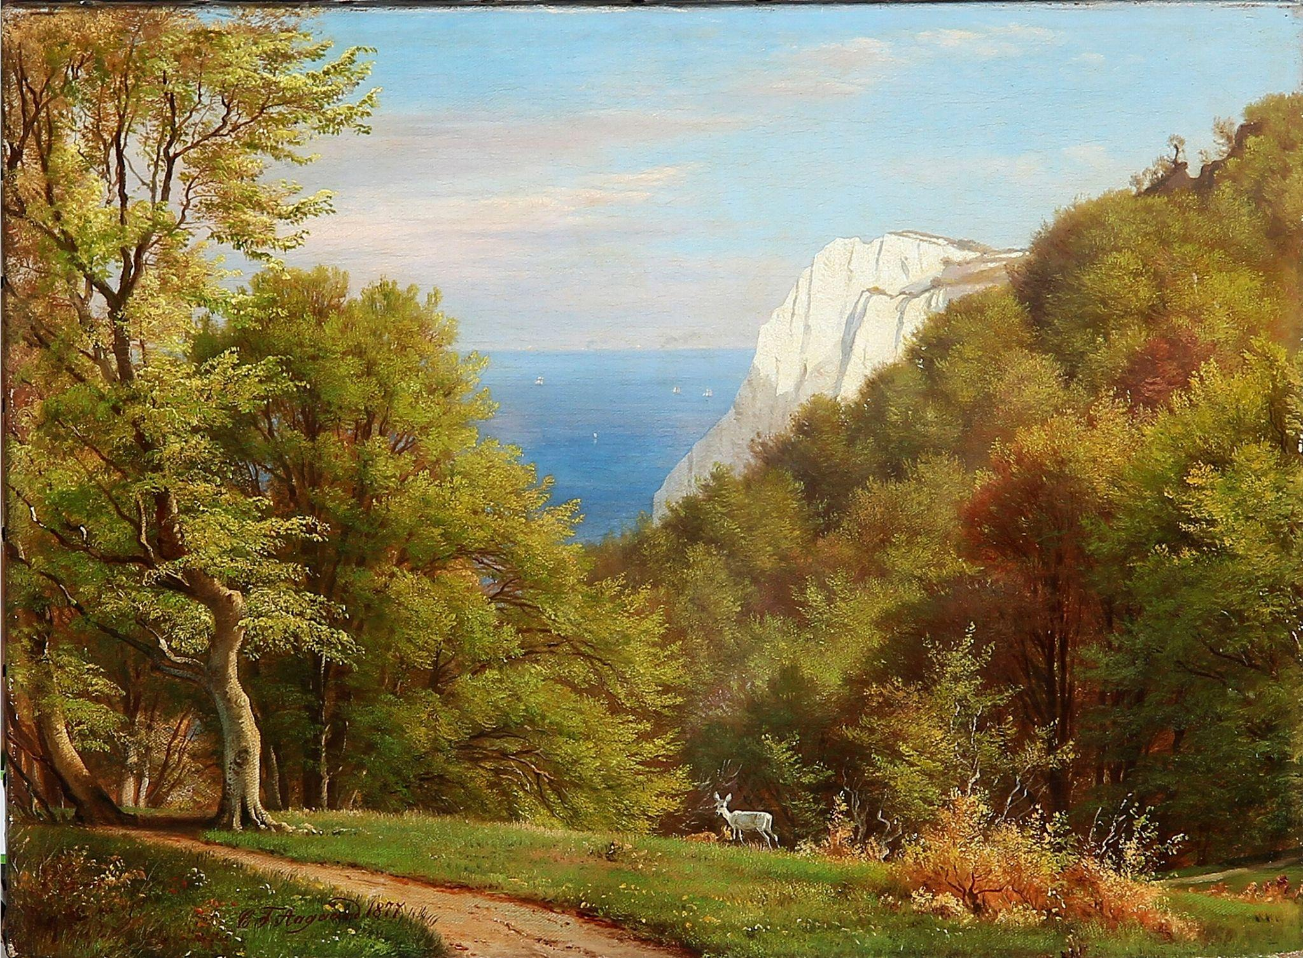
4. Nature as Alive
The natural world has value in itself and all living beings are worthy of respect and care. Rocks and trees, hills and rivers are not simply facts in the world; they are also acts of self-realization. The whole of nature is alive with value. We humans dwell within, not apart from, the Ten Thousand Things. We, too, have value.

Slide 6
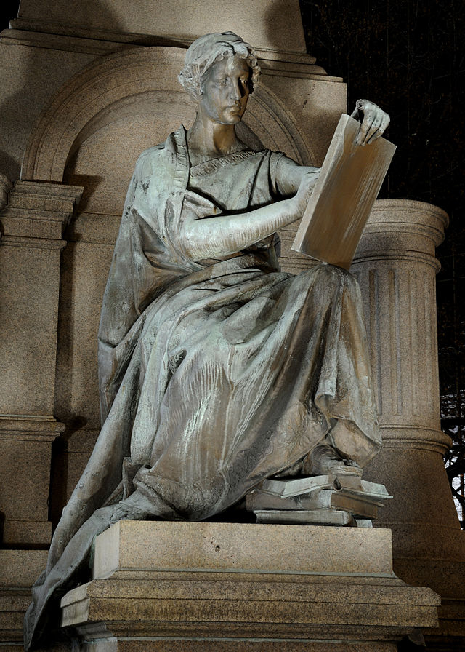
5. Ethics
Humans find their fulfillment in living in harmony with the earth and compassionately with each other. The ethical life lies in living with respect and care for other people and the larger community of life. Justice is fidelity to the bonds of relationship. A just society is also a free and peaceful society. It is creative, compassionate, participatory, ecologically wise, and spiritually satisfying - with no one left behind.

Slide 7
6. Novelty
Humans find their fulfillment in being open to new ideas, insights, and experiences that may have no parallel in the past. Even as we learn from the past, we must be open to the future. God is present in the world, among other ways, through novel possibilities. Human happiness is found, not only in wisdom and compassion, but also in creativity.

Slide 8
7. Thinking and Feeling
The human mind is not limited to reasoning but also includes feeling, intuiting, imagining; all of these activities can work together toward understanding. Even reasoning is a form of feeling: that is, feeling the presence of ideas and responding to them. There are many forms of wisdom: mathematical, spatial, verbal, kinesthetic, empathic, logical, and spiritual.

Slide 9
8. Relational Selfhood
Human beings are not skin-encapsulated egos cut off from the world by the boundaries of the skin, but persons-in-community whose interactions with others are partly definitive of their own internal existence. We depend for our existence on friends, family, and mentors; on food and clothing and shelter; on cultural traditions and the natural world. The communitarians are right: there is no "self" apart from connections with others. The individualists are right, too. Each person is unique, deserving of respect and care. Other animals deserve respect and care, too.

Slide 10
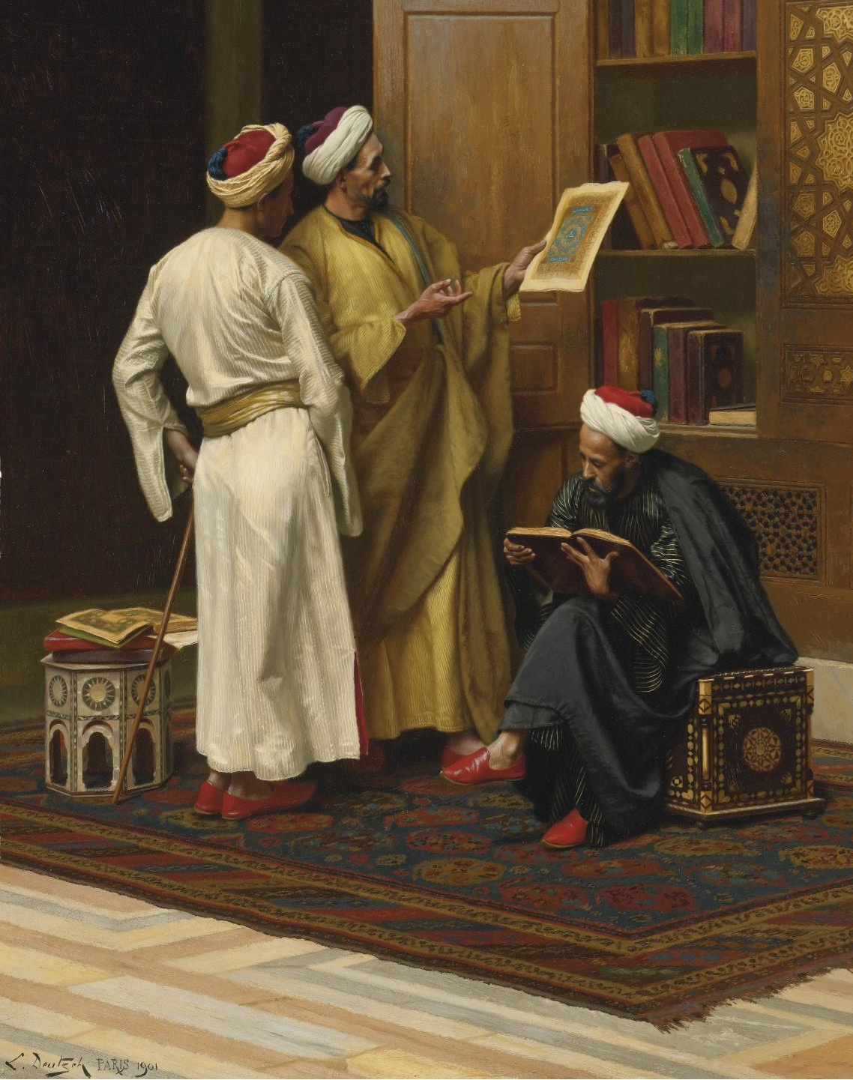
9. Complementary Thinking
The process way leans toward both-and thinking, not either-or thinking. The rational life consists not only of identifying facts and appealing to evidence, but taking apparent conflicting ideas and showing how they can be woven into wholes, with each side contributing to the other. In Whitehead’s thought these wholes are called contrasts. To be "reasonable" is to be empirical but also imaginative: exploring new ideas and seeing how they might fit together, complementing one another.

Slide 11
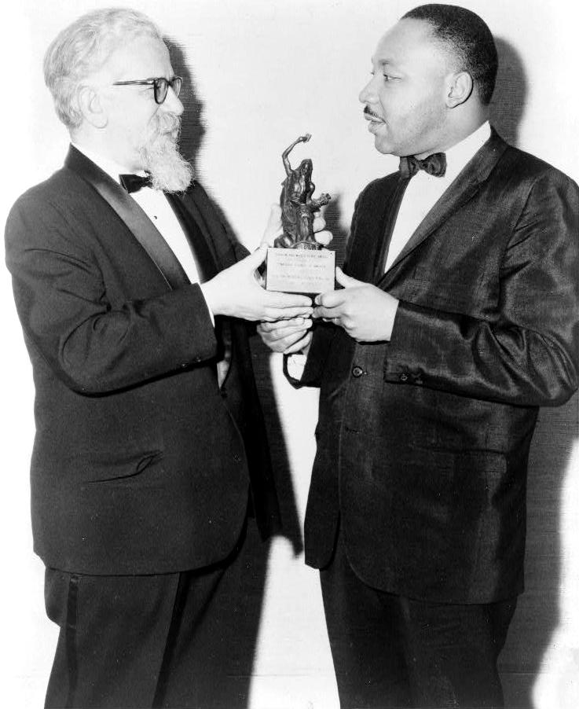
10. Theory and Practice
Theory affects practice and practice affects theory; a dichotomy between the two is false. What people do affects how they think and how they think affects what they do. Learning can occur from body to mind: that is, by doing things; and not simply from mind to body.

Slide 12
11. The Primacy of Persuasion over Coercion
There are two kinds of power – coercive power and persuasive power – and the latter is to be preferred over the former. Coercive power is the power of force and violence; persuasive power is the power of invitation and moral example.

Slide 13
12. Relational Power
This is the power that is experienced when people dwell in mutually enhancing relations, such that both are “empowered” through their relations with one another. In international relations, this would be the kind of empowerment that occurs when governments enter into trade relations that are mutually beneficial and serve the wider society; in parenting, this would be the power that parents and children enjoy when, even amid a hierarchical relationship, there is respect on both sides and the relationship strengthens parents and children.

Slide 14
13. The Primacy of Particularity
There is a difference between abstract ideas that are abstracted from concrete events in the world, and the events themselves. The fallacy of misplaced concreteness lies in confusing the abstractions with the concrete events and focusing more on the abstract than the particular.

Slide 15
14. Experience in the Mode of Causal Efficacy
Human experience is not restricted to acting on things or actively interpreting a passive world. It begins by a conscious and unconscious receiving of events into life and being causally affected or influenced by what is received. This occurs through the mediation of the body but can also occur through a reception of the moods and feelings of other people (and animals).

Slide 16
15. Concern for the Vulnerable
Humans are gathered together in a web of felt connections, such that they share in one another’s sufferings and are responsible to one another. Humans can share feelings and be affected by one another’s feelings in a spirit of mutual sympathy. The measure of a society does not lie in questions of appearance, affluence, and marketable achievement, but in how it treats those whom Jesus called "the least of these" – the neglected, the powerless, the marginalized, the otherwise forgotten.

Slide 17
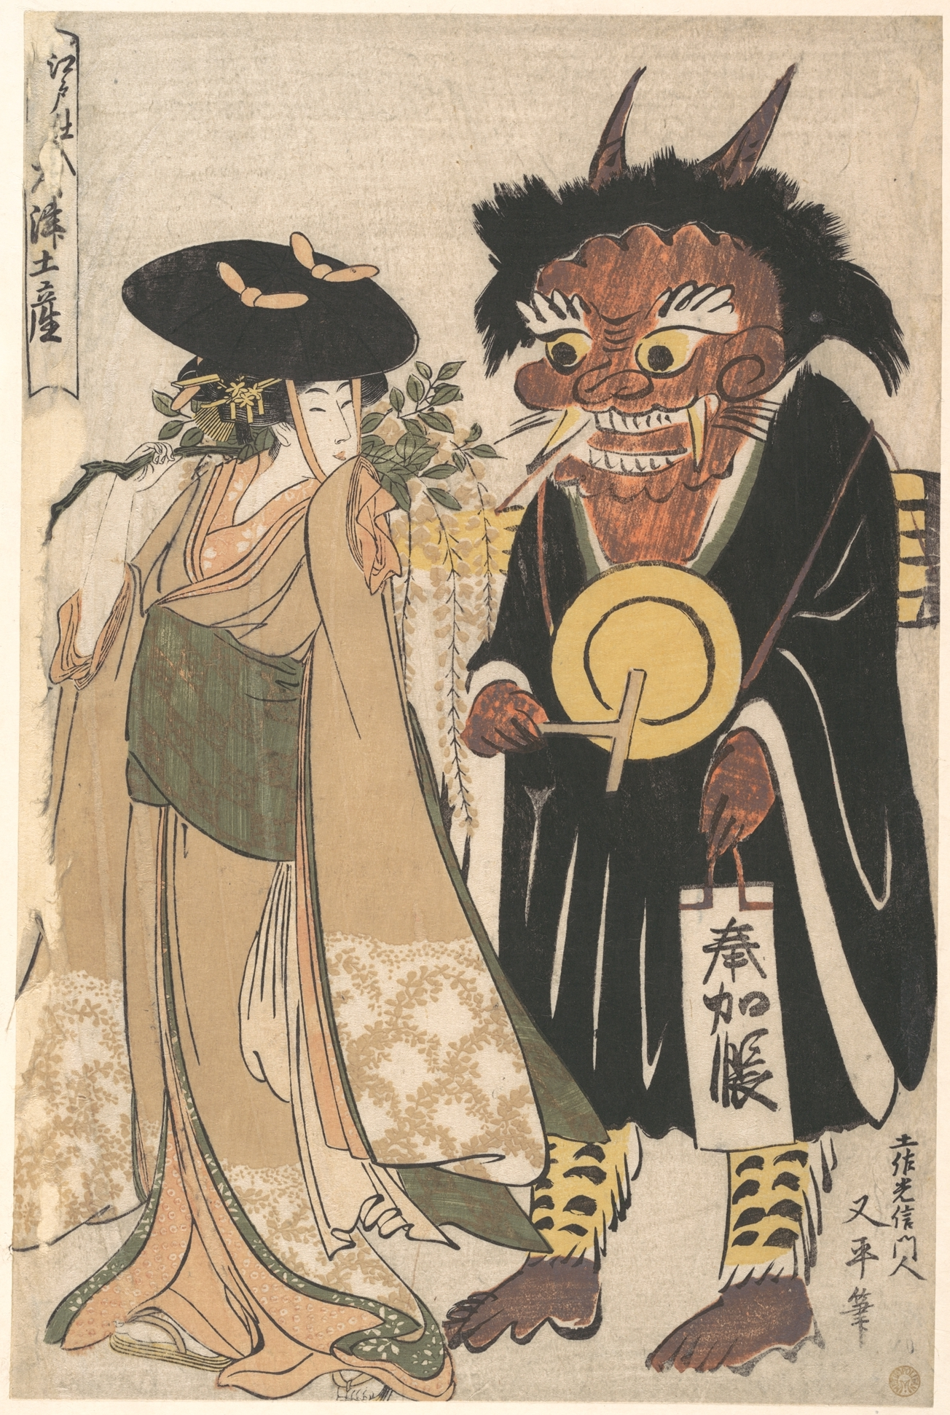
16. Evil
“Evil” is a name for debilitating suffering from which humans and other living beings suffer, and also for the missed potential from which they suffer. Evil is powerful and real; it is not merely the absence of good. “Harm” is a name for activities, undertaken by human beings, which inflict such suffering on others and themselves, and which cut off their potential. Evil can be structural as well as personal. Systems—not simply people—can be conduits for harm.

Slide 18
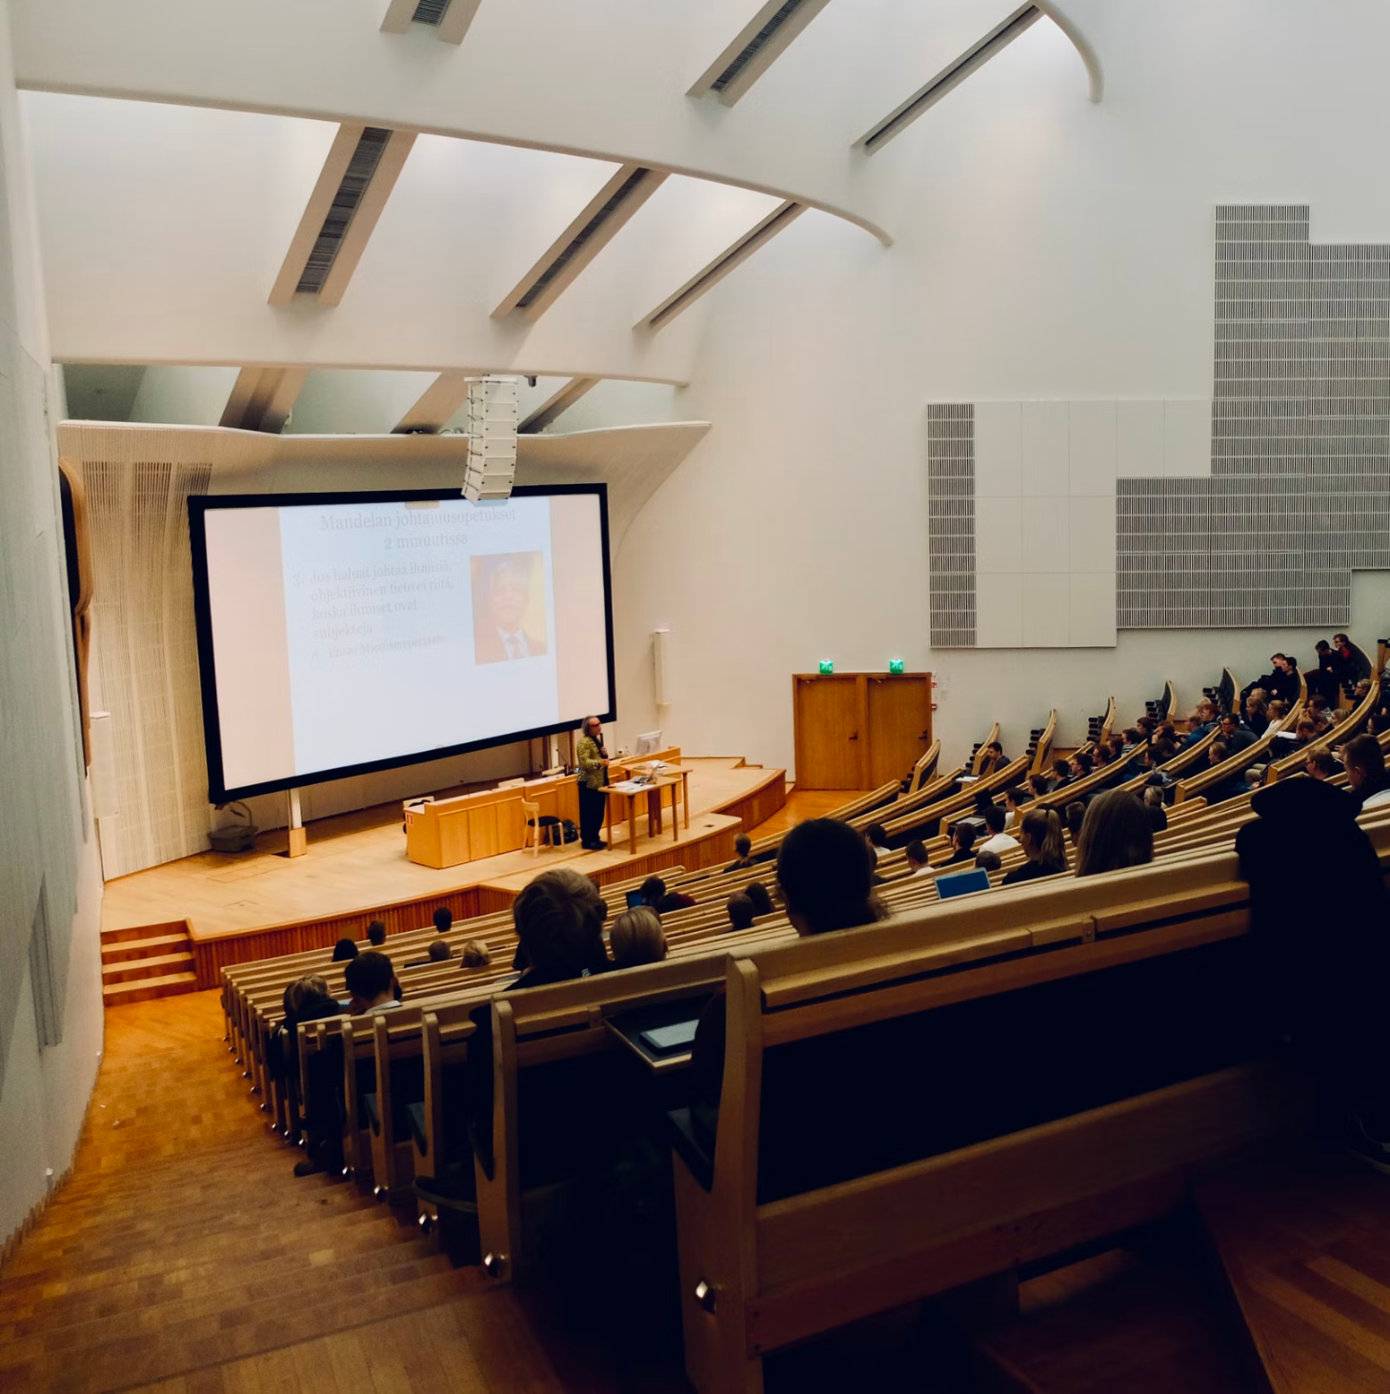
17. Education as a Lifelong Process
Human life is itself a journey from birth (and perhaps before) to death (and perhaps after) and the journey is itself a process of character development over time. Formal education in the classroom is a context to facilitate the process, but the process continues throughout a lifetime. Education requires romance, precision, and generalization. Learning is best when people want to learn.

Slide 19
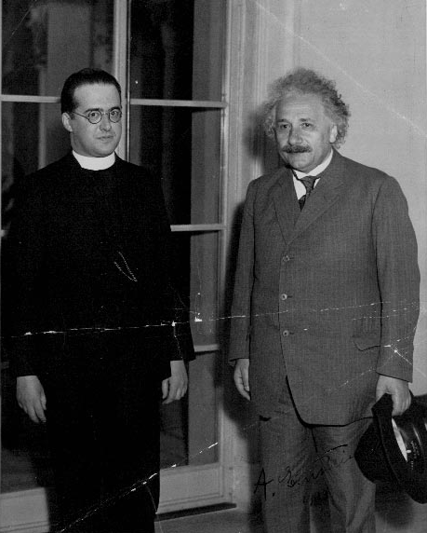
18. Religion and Science
Religion and Science are both human activities, evolving over time, which can be attuned to the depths of reality. Science focuses on forms of energy which are subject to replicable experiments and which can be rendered into mathematical terms; religion begins with awe at the beauty of the universe, awakens to the interconnections of things, and helps people discover the norms which are part of the very make-up of the universe itself.

Slide 20
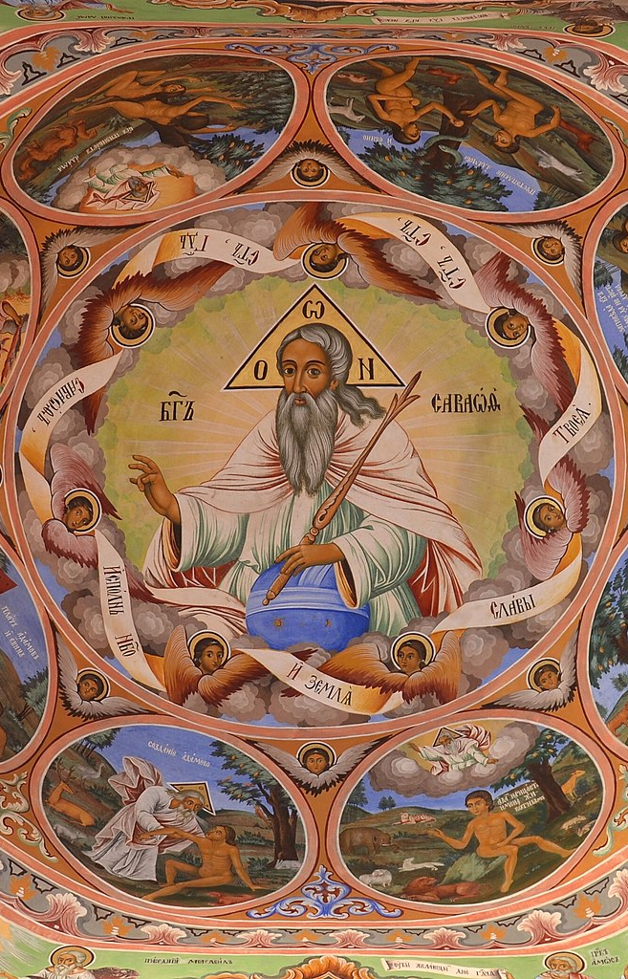
19. God
The universe unfolds within a larger life—a love supreme—who is continuously present within each actuality as a lure toward wholeness relevant to the situation at hand. In human life we experience this reality as an inner calling toward wisdom, compassion, and creativity. Whenever we see these three realities in human life we see the presence of this love, thus named or not. This love is the Soul of the universe and we are small but included in its life not unlike the way in which embryos dwell within a womb, or fish swim within an ocean, or stars travel through the sky.

Slide 21
19. God
This Soul can be addressed in many ways, and one of the most important words for addressing the Soul is “God.” The stars and galaxies are the body of God and any forms of life which exist on other planets are enfolded in the life of God, as is life on earth. God is a circle whose center is everywhere and circumference nowhere. As God beckons human beings toward wisdom, compassion, and creativity, God does not know the outcome of the beckoning in advance, because the future does not exist to be known. But God is steadfast in love; a friend to the friendless; and a source of inner peace. God can be conceived as “father” or “mother” or “lover” or “friend.” God is love.

Slide 22
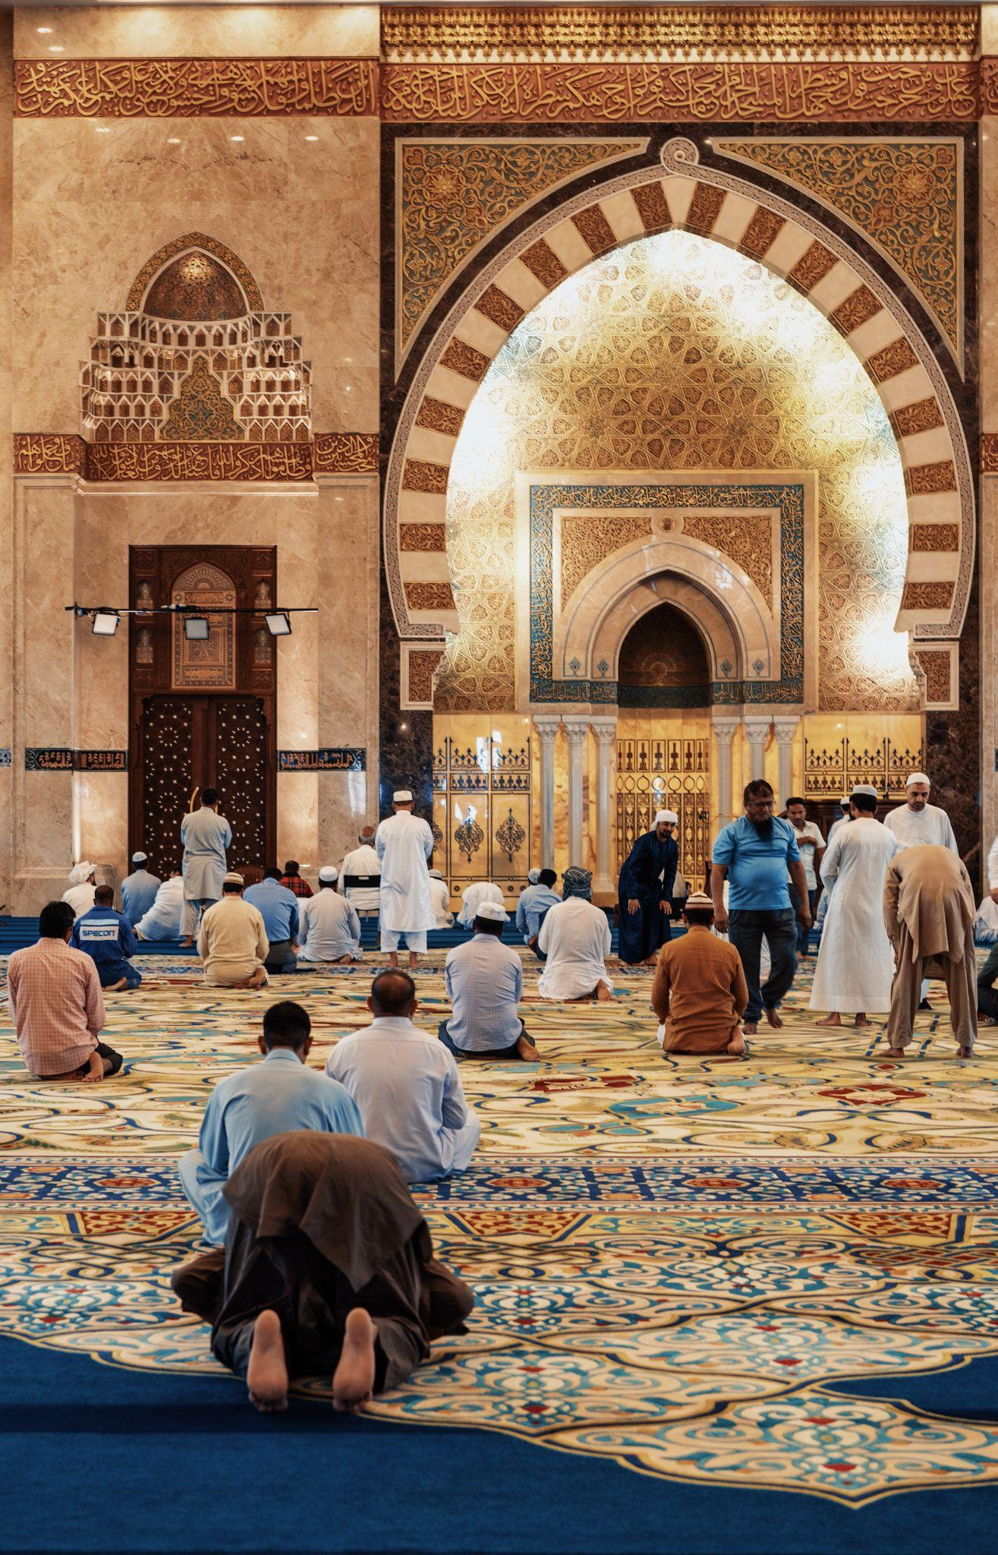
20. Faith
Faith is not intellectual assent to creeds or doctrines but rather trust in divine love. To trust in love is to trust in the availability of fresh possibilities relative to each situation; to trust that love is ultimately more powerful than violence; to trust that even the galaxies and planets are drawn by a loving presence; and to trust that, no matter what happens, all things are somehow gathered into a wider beauty. This beauty is the Adventure of the Universe as One.

Slide 23
cobb.institute

