Slide 1
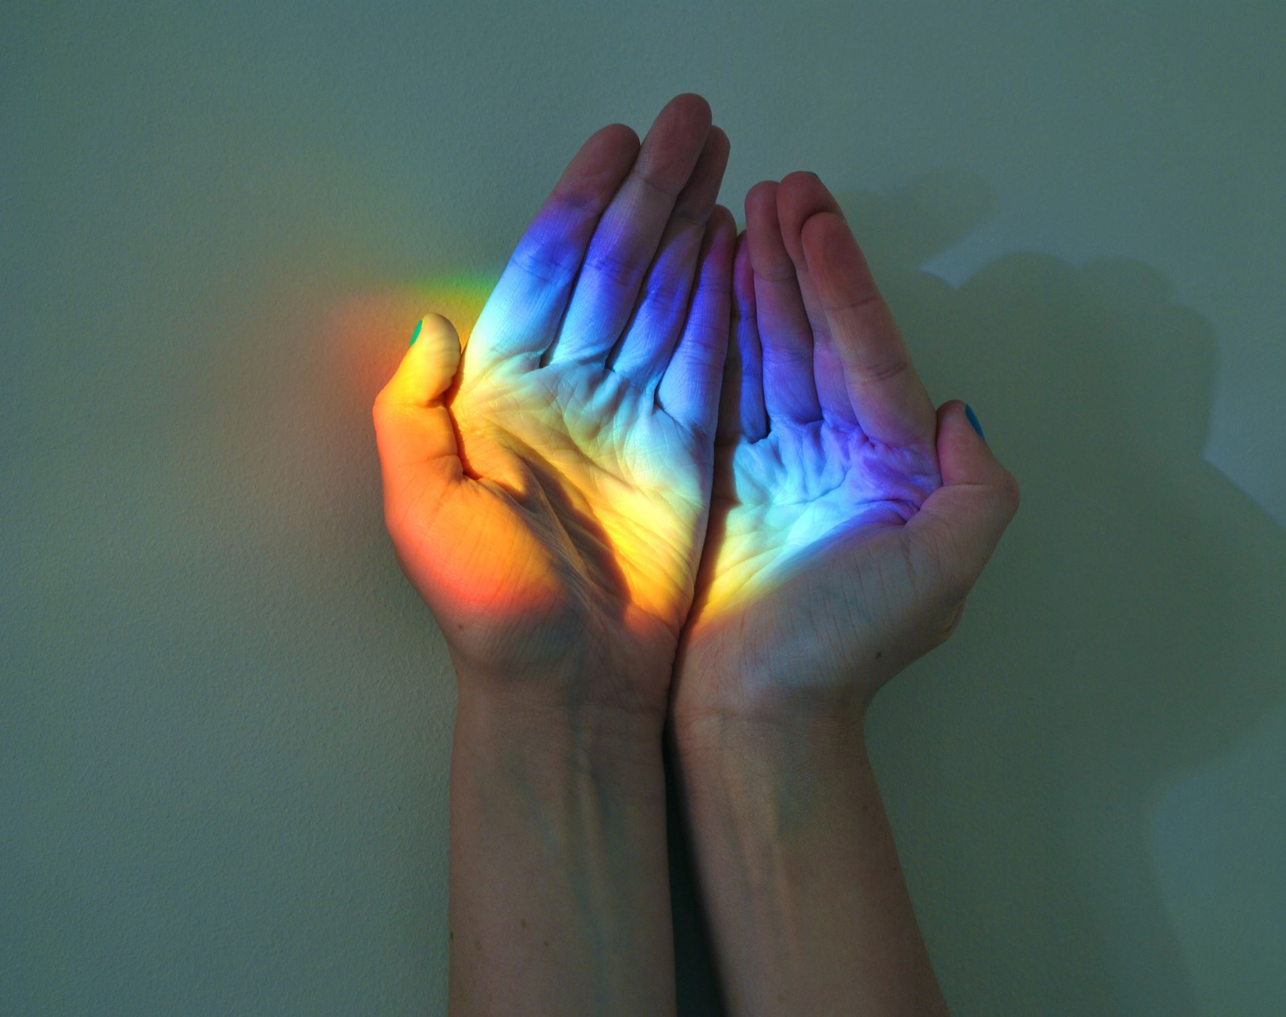
A Process Spirituality:
Whitehead
& Jung
SHERI D. KLING, PH.D.

Slide 2
What is Spirituality?
According to David B. Perrin, spirituality integrates all aspects of life into a unified whole, allowing life to be marked by the “overall spirit of goodwill” inherent in authentic living.

Slide 3
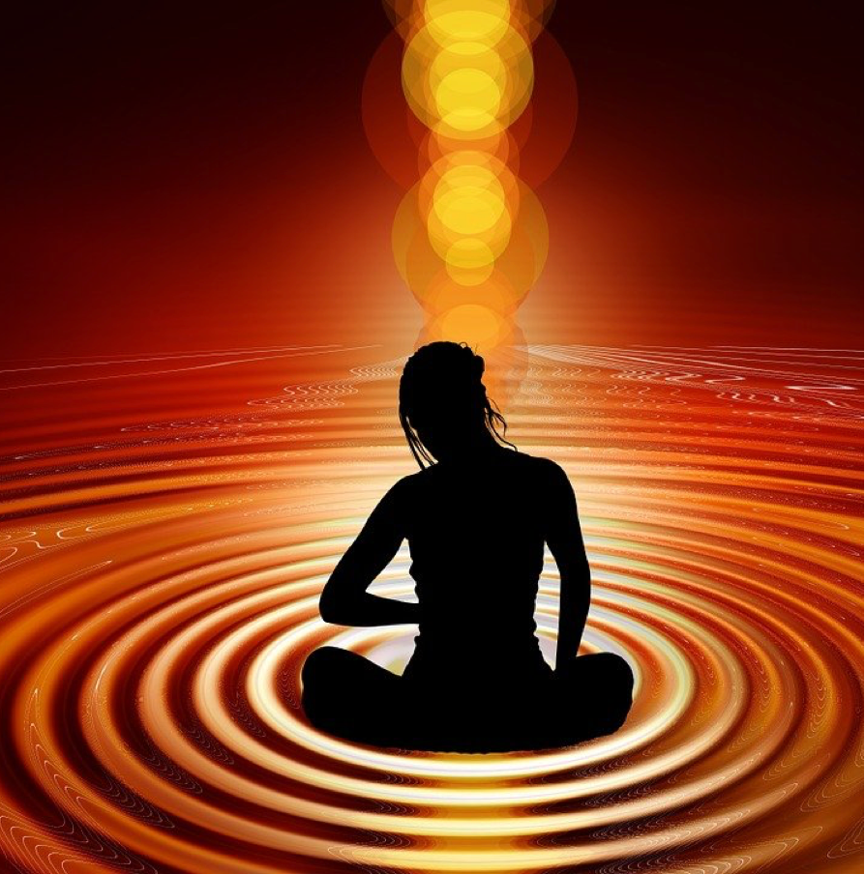
What is Spirituality?
Such authentic spirituality opens us to healthy self-critique, self-knowledge, and self-giving.
It can be understood as something intrinsic to human nature.
It includes a capacity for both transcendence and self-transcendence.
It is a “lived reality that is shaped into a way of life.”

Slide 4
What is Spirituality?
Drawing from Whitehead and process theologian John B. Cobb, we might also say that spirituality is how we are inwardly animated and enlivened, often by the “felt beauty” we experience in the natural world and in our relationships. It is the seeking and sustaining of rich experience in community with others and also in the solitariness of the heart.

Slide 5
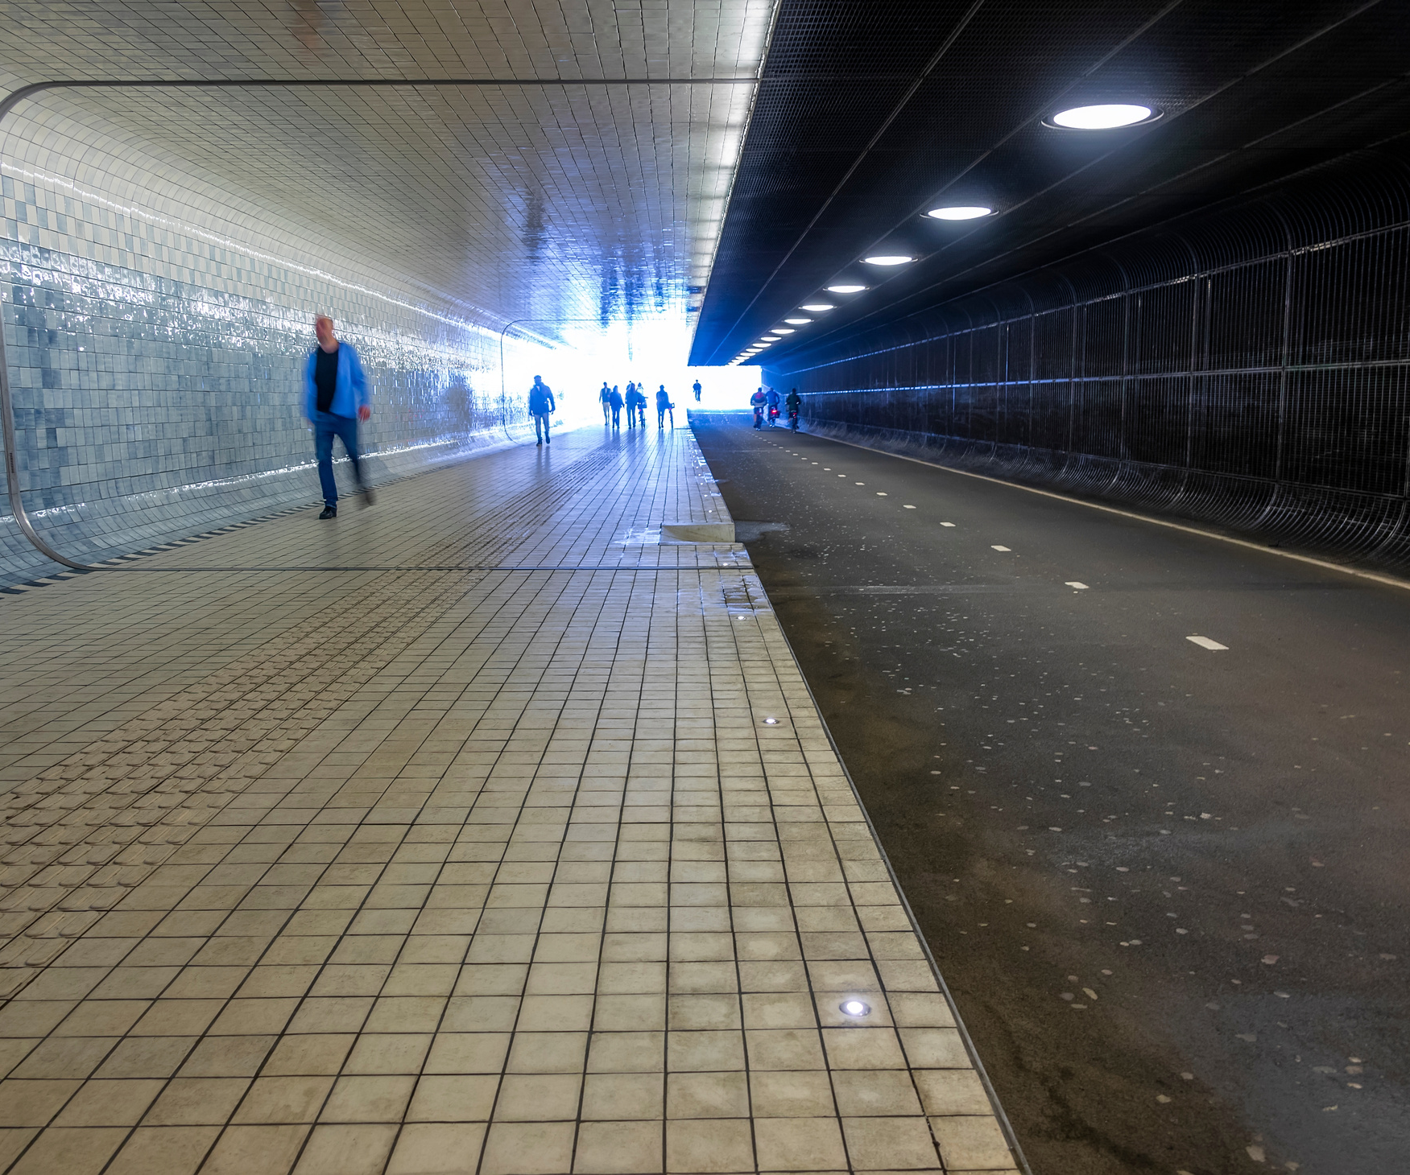
Blocks to Healthy Spirituality
A solely transcendent view of the divine that leaves the world incapable of communicating divine presence
A dualistic view that separates mind, body, and nature
The idea that the earth and its beings are basically machines that can be reduced to parts and therefore have no wholeness

Slide 6
Blocks to Healthy Spirituality
The dismissal of the nonrational aspects of life – emotion, religious experience, deep unconscious forces of the psyche
The collapse of the transpersonal or religious; humans without targets for projection of their inner religious energies will then project those energies onto other people and social movements, infusing them with religious zeal that they cannot contain in a healthy way

Slide 7
The Spiritual Wholeness We Need
To understand all aspects of our lives as one coherent whole
To see life and ourselves as meaningful
To see ourselves in relationship to the whole, interconnected with it
To know ourselves as able to experience positive change
To understand Reality at both the level of cosmos and of psyche as being integrated and able to facilitate our own wholeness

Slide 8
The Spiritual Wholeness We Need
Wholeness is also a feeling of “at homeness”
or “at-onement” – it is feeling undivided.

Slide 9
A Wounding and Healing Reality
Reality is marked by change, flux, and perishing – it is inherently wounding
There is also what we might call a “primordial mystery” at the base of life – a rushing river of being that is our source of dynamism, vitality, and creativity

Slide 10
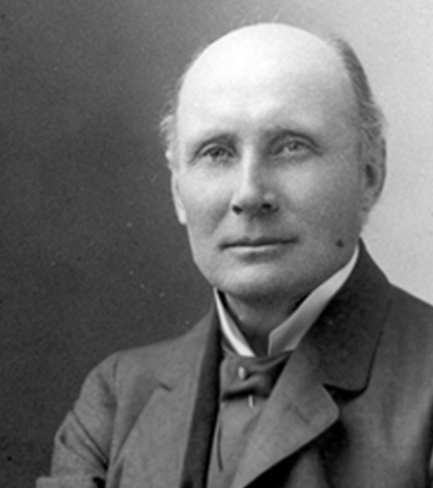
Resources for Wholeness: Whitehead
Reality is dynamic and creative, made up of events or “drops of experience”
All things are interrelated and interconnected
All things are subjects with an inner life and some degree of experience

Slide 11
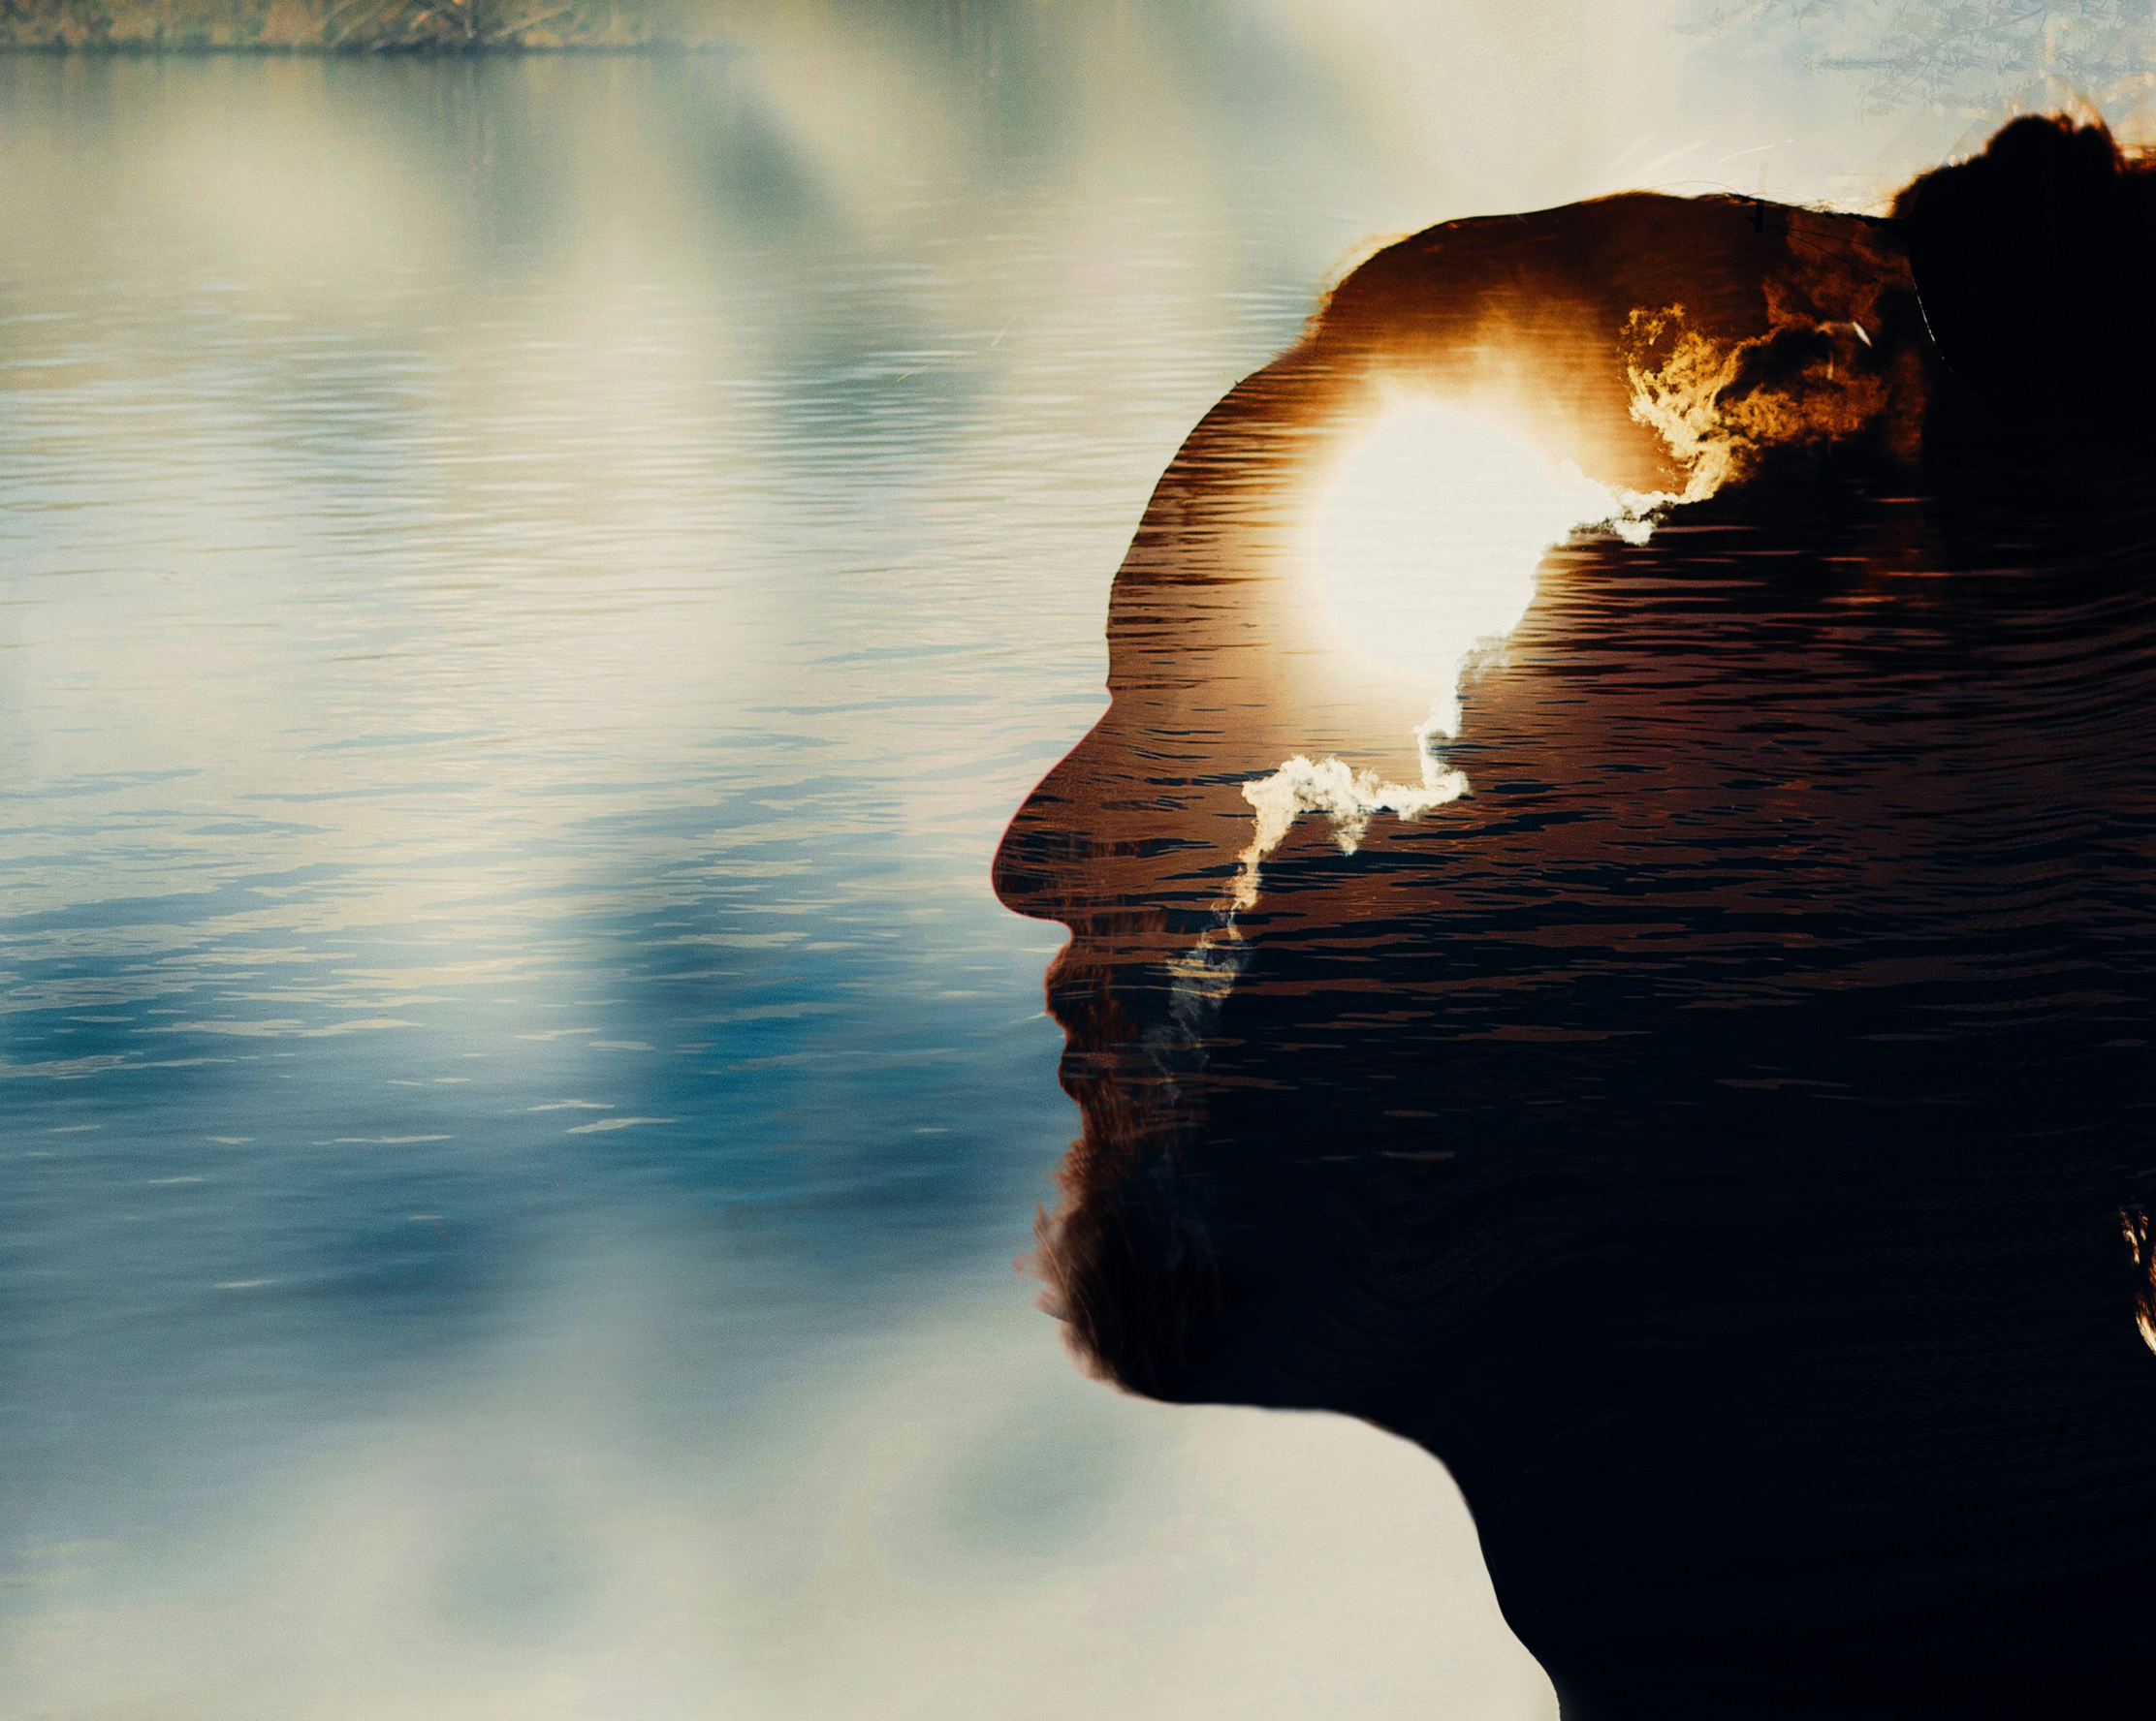
Resources for Wholeness: Whitehead
At the beginnings of experience, every moment of becoming encounters the “Other” of the objective world of past fact and is formed by that world
All things have both mental and physical aspects that are intimately intertwined - body and mind, and body and world are unified

Slide 12
Resources for Wholeness: Whitehead
The divine is immanent in the world and offers it wholeness, order, and novelty, luring all things forward toward integration and enjoyment
Every thing has inherent value, actualizes value, and seeks its own enjoyment

Slide 13
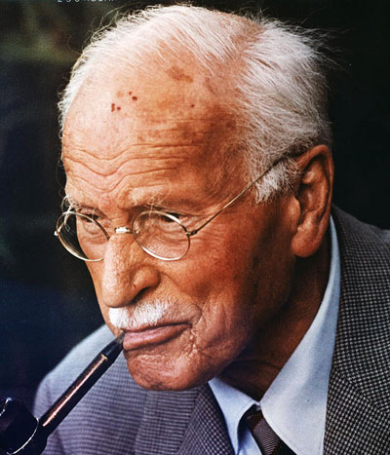
Resources for Wholeness: Jung
The human psyche is dynamic and made up of ego consciousness, a personal unconscious, and a collective unconscious
Conscious and unconscious psyche are in a balancing relationship where what is unconscious for us can expand our awareness when brought to consciousness

Slide 14
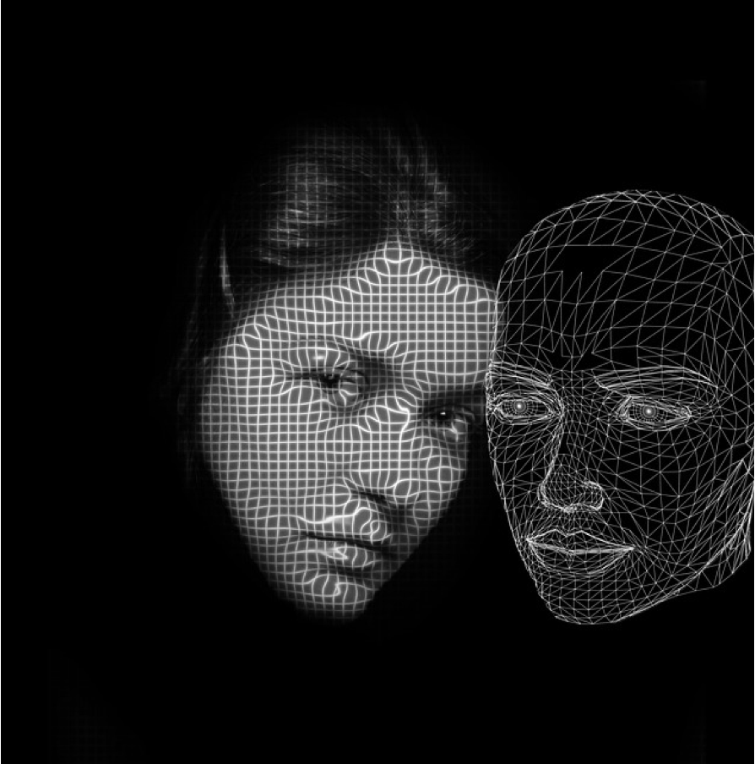
Resources for Wholeness: Jung
At the depths of experience, we encounter an objective “Other,” the “objective psyche” that confronts and changes us
Body and mind, soma and psyche, cannot be separated but are joined through symbol and image – psyche, body, and world are connected through meaning and patterns of value

Slide 15
Resources for Wholeness: Jung
The sacred is present and active in the human psyche as the archetypal Self, the God-image in the psyche that facilitates individuation and wholeness
The purpose of individuation is to actualize value and “one’s own being” in the world

Slide 16
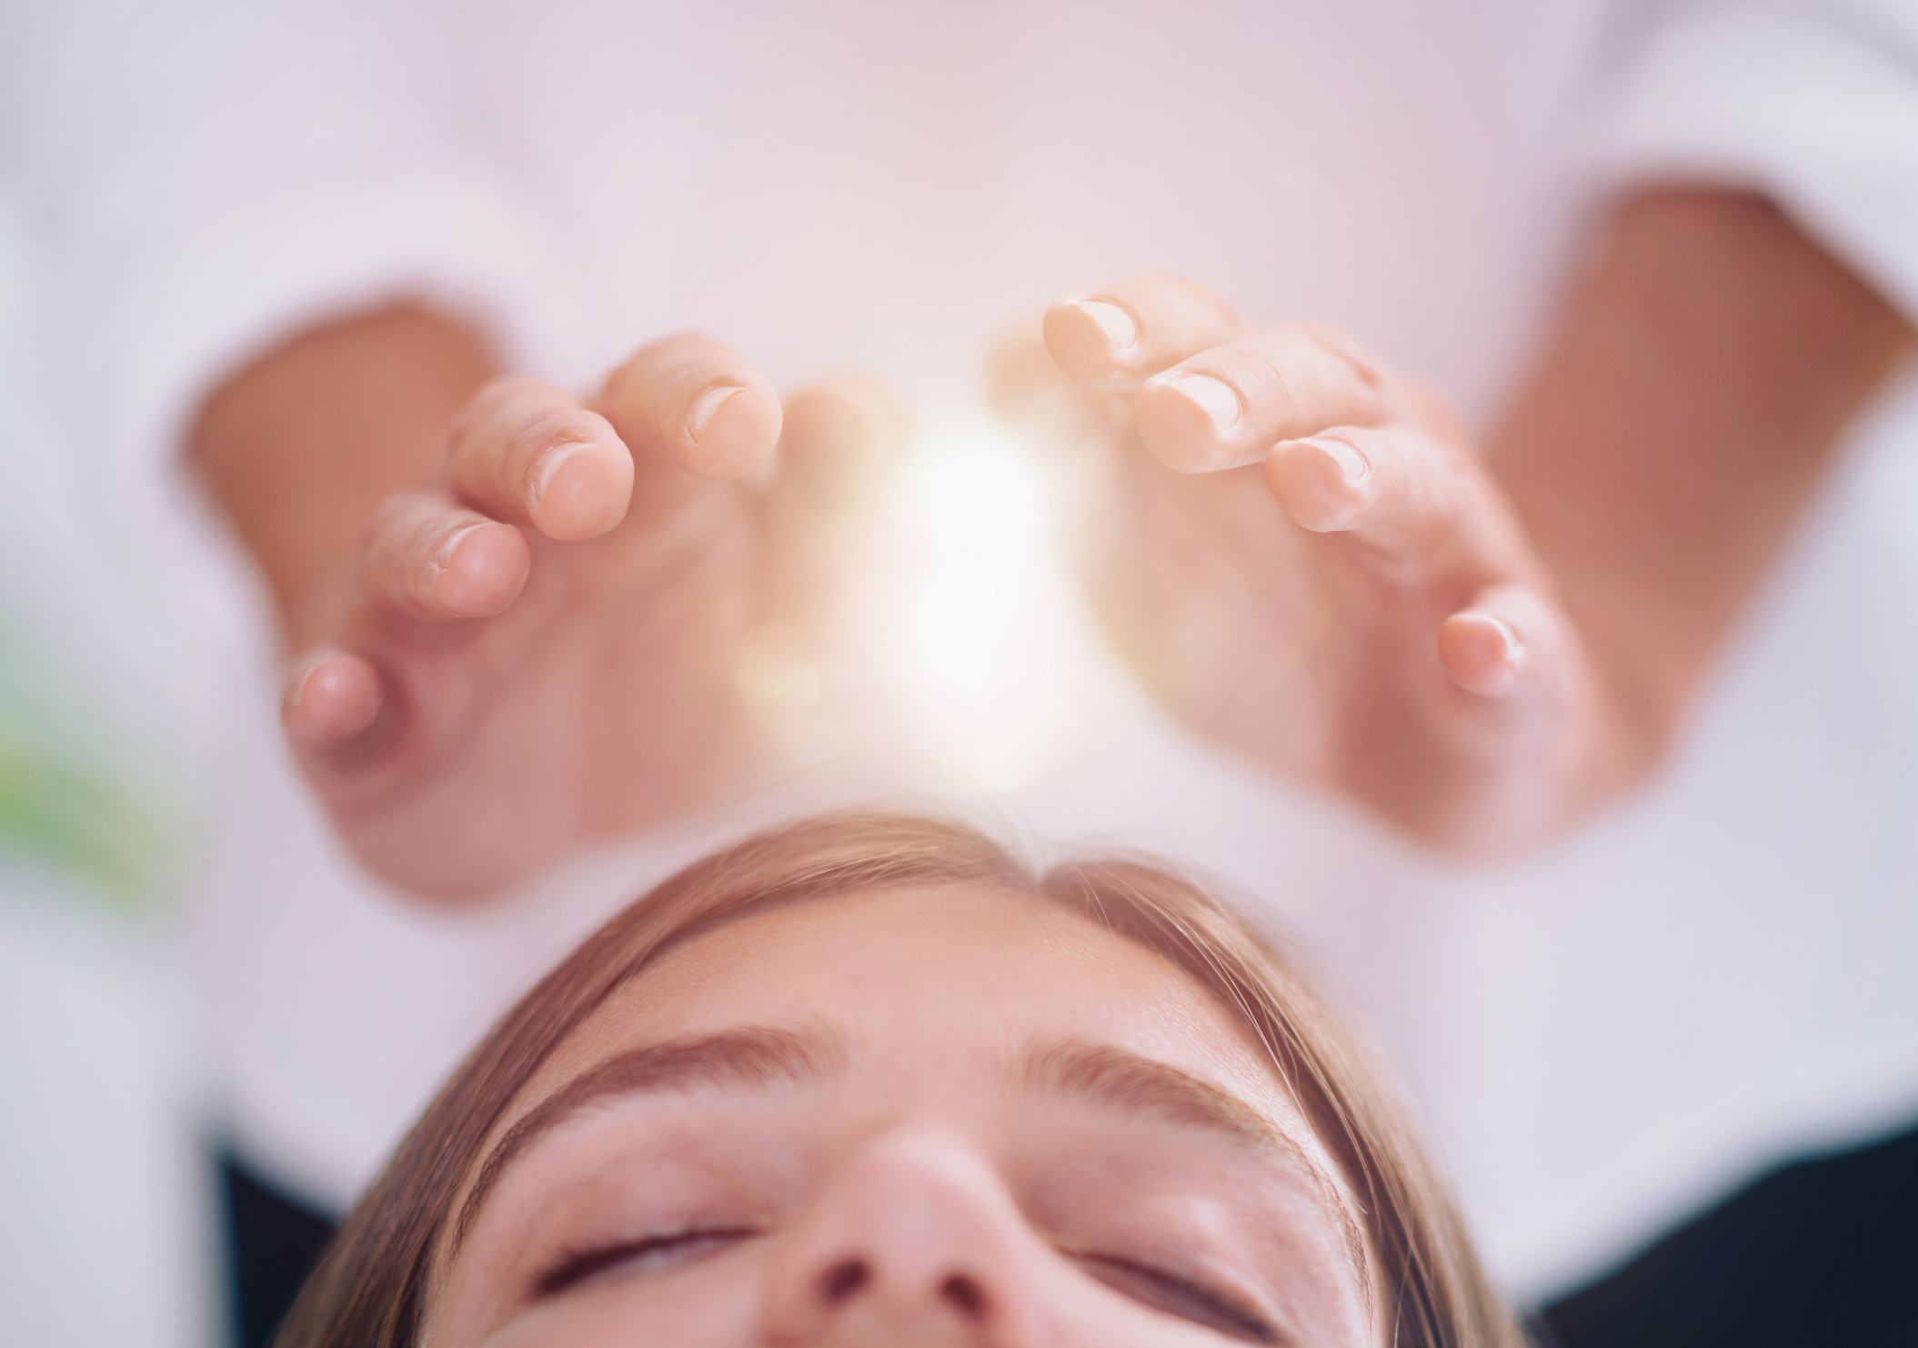
Wholeness and Flourishing
By drawing from Whitehead and Jung, we might say that when we align with the sacred flow of life, we may:
Discern the highest possibilities that we might actualize in every moment
Heal the wounds and unconscious aspects of our psyche that keep us stuck in the past and in reactive mode, becoming more capable of engaging the world as it is in the present moment

Slide 17
Wholeness and Flourishing
Integrate the polarizing forces at work in our psyche – the ways we are divided against ourselves – by being open to novel and expanded perspectives that transcend but include those opposing energies
Allow these expanded perspectives to bring us to new ways of living that are more compassionate, more loving, more beautiful, and more harmonious

Slide 18
A Spiritual Practice of Dream Work
While there are many kinds of spiritual practices, a Jungian-style practice of working with our dreams in a spiritual way helps us to:
Discern our deeper callings and soul stirrings
Bring unconscious material to consciousness which allows us to heal our wounds and move toward greater wholeness

Slide 19
A Spiritual Practice of Dream Work
Improve our relationships with others because when we become conscious of our complexes and projections onto others, we can withdraw those projections and experience less emotional reactivity.
Respond to the dynamic flow of life by engaging it as it is in the present moment.
Feel ourselves to be connected to all of life because we are having sacred encounters within our embodied lives

Slide 20
What Does this Mean?
Thinking with Whitehead and Jung, we might say that Reality at both the level of the cosmos and of the psyche is marked by:
Value
Relationality
Transformation
The immanent presence of the sacred or divine within the human and the whole world

Slide 21
What Does this Mean?
When we experience that Reality for ourselves through spiritual practices that foster embodied experiences of wholeness, we learn:
We matter
We belong
We can experience positive change
And this is true universally

Slide 22
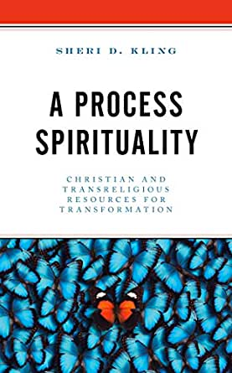
cobb.institute

