Slide 1
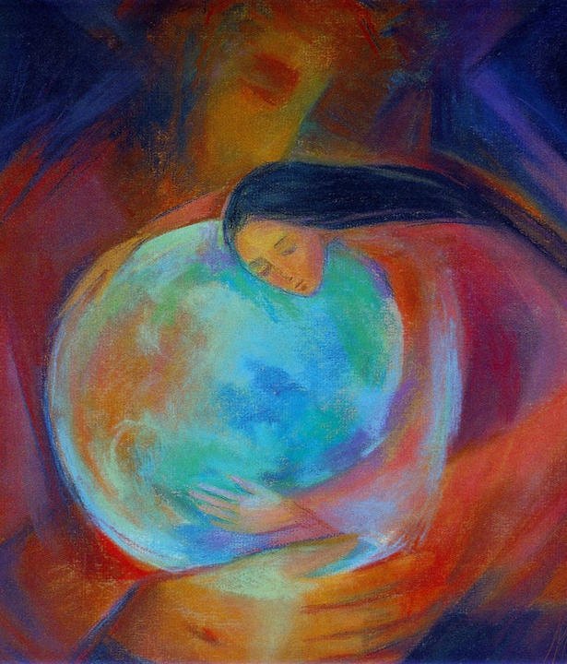
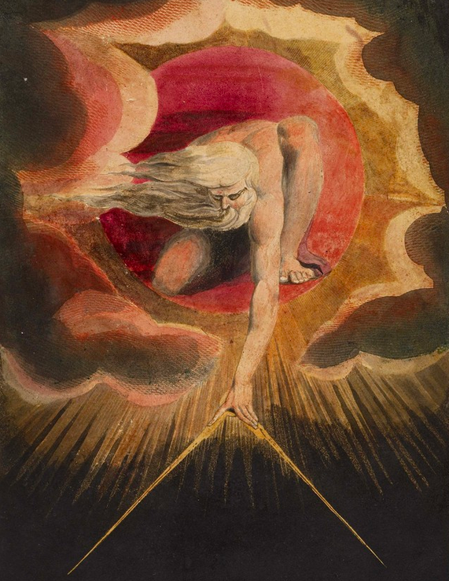
God in
Process
Theology
Six Approaches
All Part of the Process Outlook

Slide 2
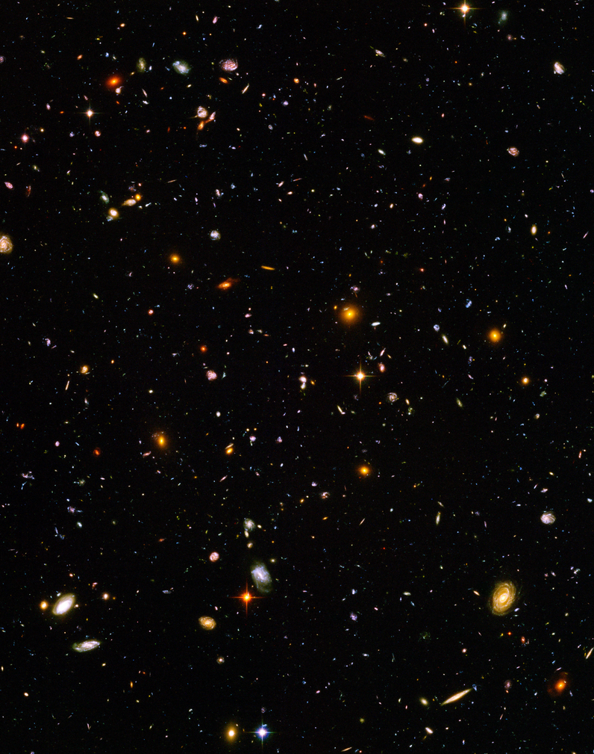
The Universe Itself
(As Interwoven with Divine Love)
The universe as the objective content of God’s ongoing experience
The universe as God’s body
The universe as the visible side of God’s life
God as Many and not just One

Slide 3
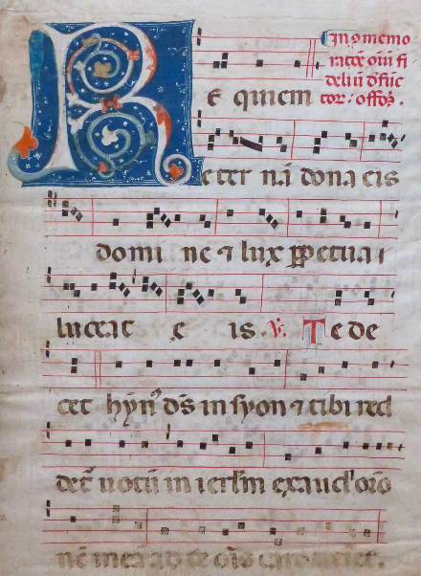
The Everlasting Song of
the Universe
God as the living whole of the universe
God as the Life of the universe
God as the adventure of the universe as One
God as the Weaver of Wholes
God as the Harmony of Harmonies

Slide 4
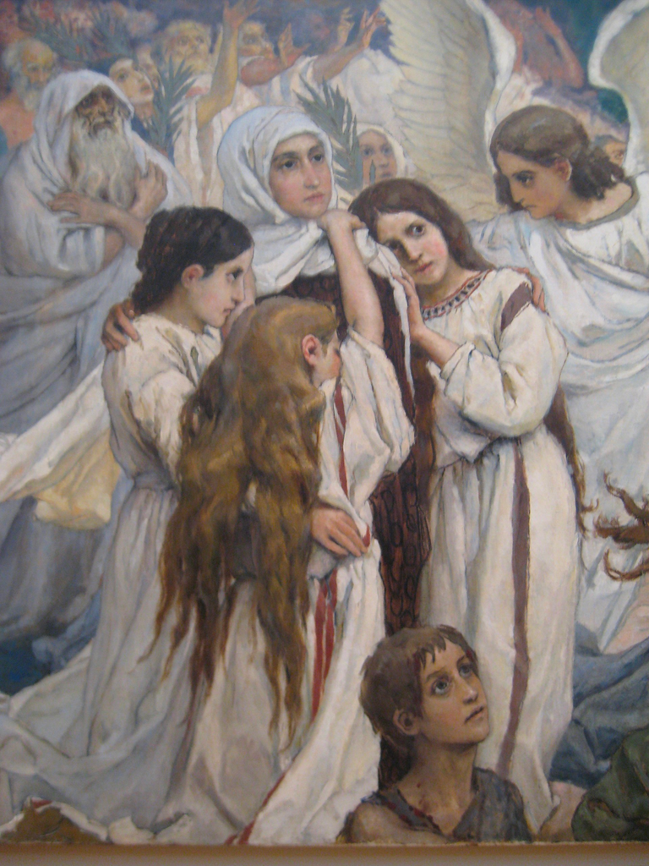
A Companion to the World’s
Sufferings and Joys
The “consequent nature of God” in Whitehead’s philosophy
God as the Deep Listening
God as the Great Compassion
God as fellow sufferer who understands
God as fellow enjoyer who co-enjoys

Slide 5
A Guiding and Animating
Energy in the Universe
God as lure towards satisfying existence, moment by moment
God as lure to beauty (harmony and intensity)
God as inner teacher and guide
God as “initial aims” in each moment of experience

Slide 6
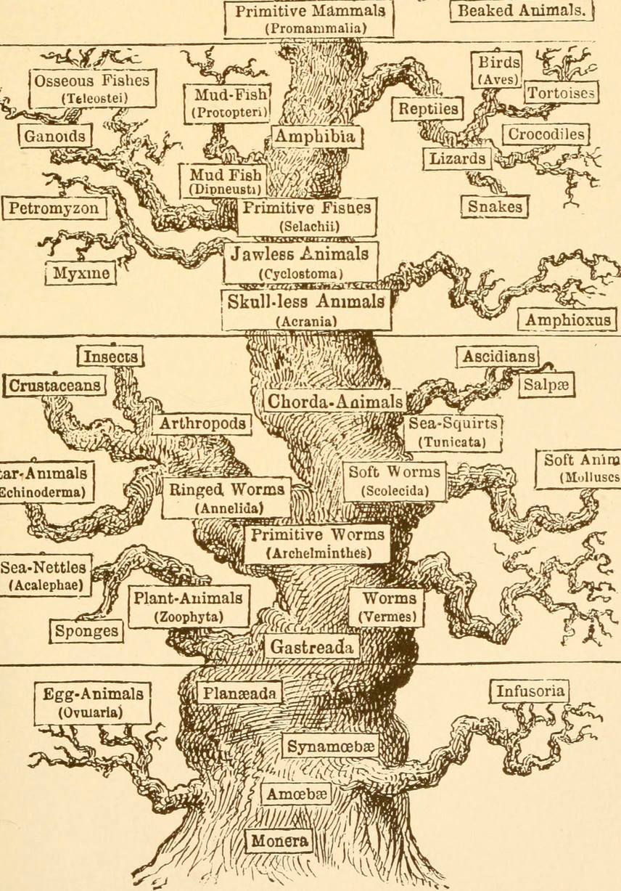
The Spirit of Creative
Transformation
God as the power of love, forgiveness, and transformation in human life
God as the power of novelty and adaptation in evolution
God as the indwelling lure towards wholeness and meaning-making

Slide 7
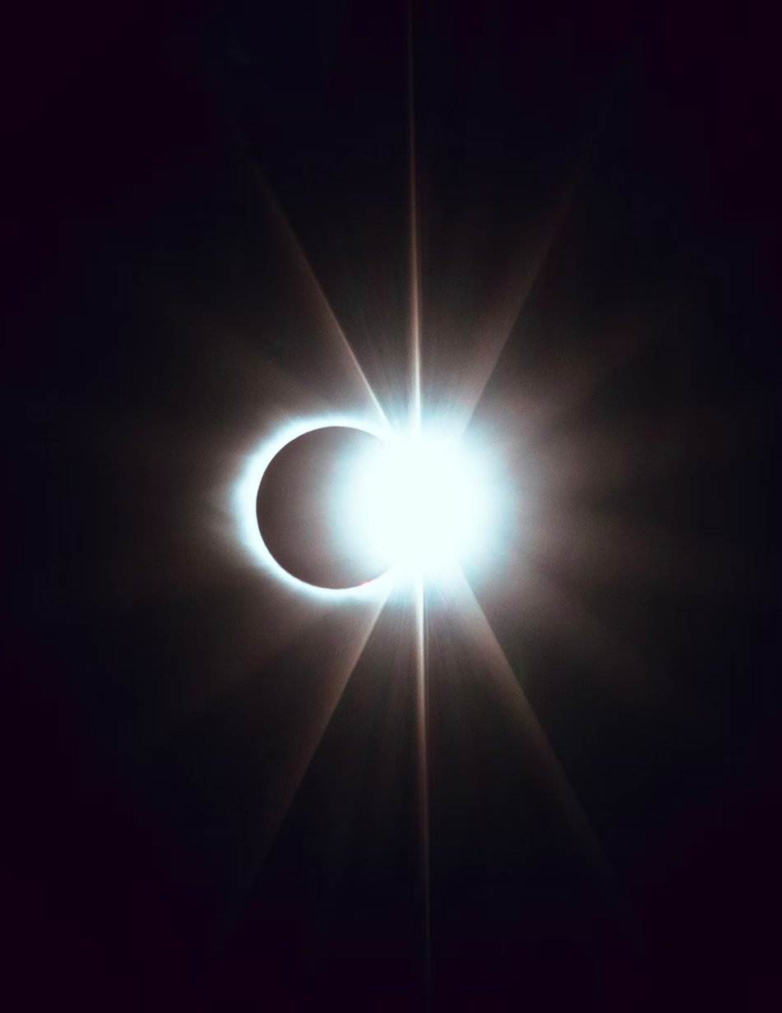
The Deep Mind of
the Universe
God’s primordial nature, beyond space and time
God as timeless mind filled with pure potentialities
God “before” creation, sometimes experienced mystically
The placeless place where there is a divine decision for order and love

Slide 8
Image Credits
Slide 1: Dance of the Seasons @ Mary Southard. Ministry of the Arts. Used with permission. https://www.ministryofthearts.org/
The Ancient of Days (1794) Watercolor etching. William Blake.
Slide 2: Hubble Ultra Deep Field. NASA and the European Space Agency.
Slide 3: Foglio membranaceo miniato. Italia, metà XVI secolo
Slide 4: The joy of the righteous about the Lord. Viktor Vasnetsov. Photo by Shakko.
Slide 5: Sunset over the horizon. Photo by Jordan Wozniak on Unsplash.
Slide 6: The evolution of man: a popular exposition of the principal points of human ontogeny and phylogene (1896). Ernst Haeckel.
Slide 7: Solar eclipse. Photo by Matt Nelson on Unsplash.

Slide 9
cobb.institute

